Slide 1
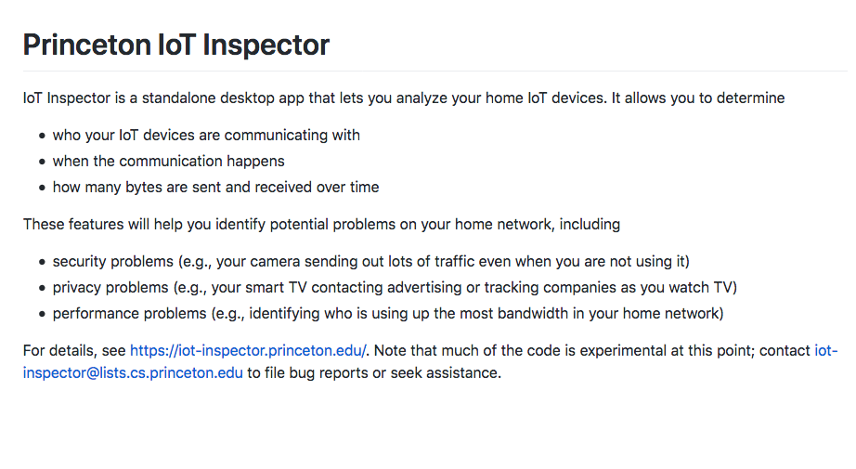
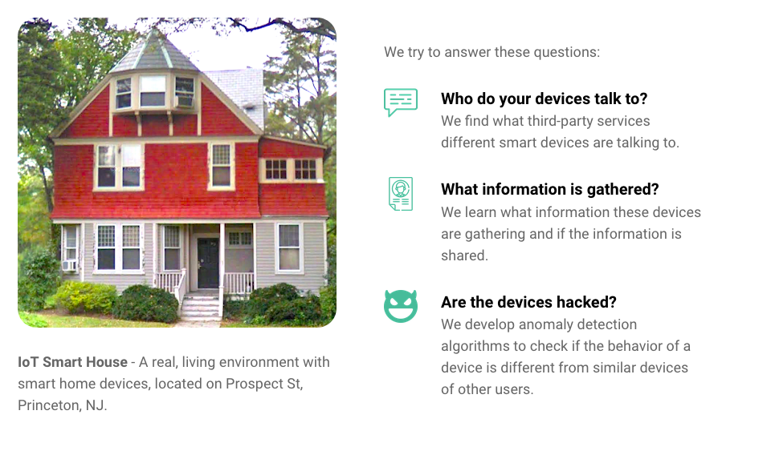
Notes:
We’ve continued to work on this over the past several years (Danny Huang).

Slide 2

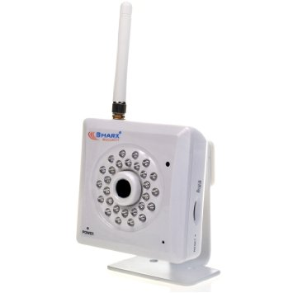

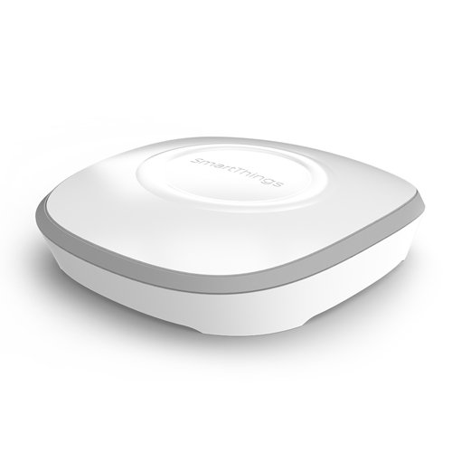

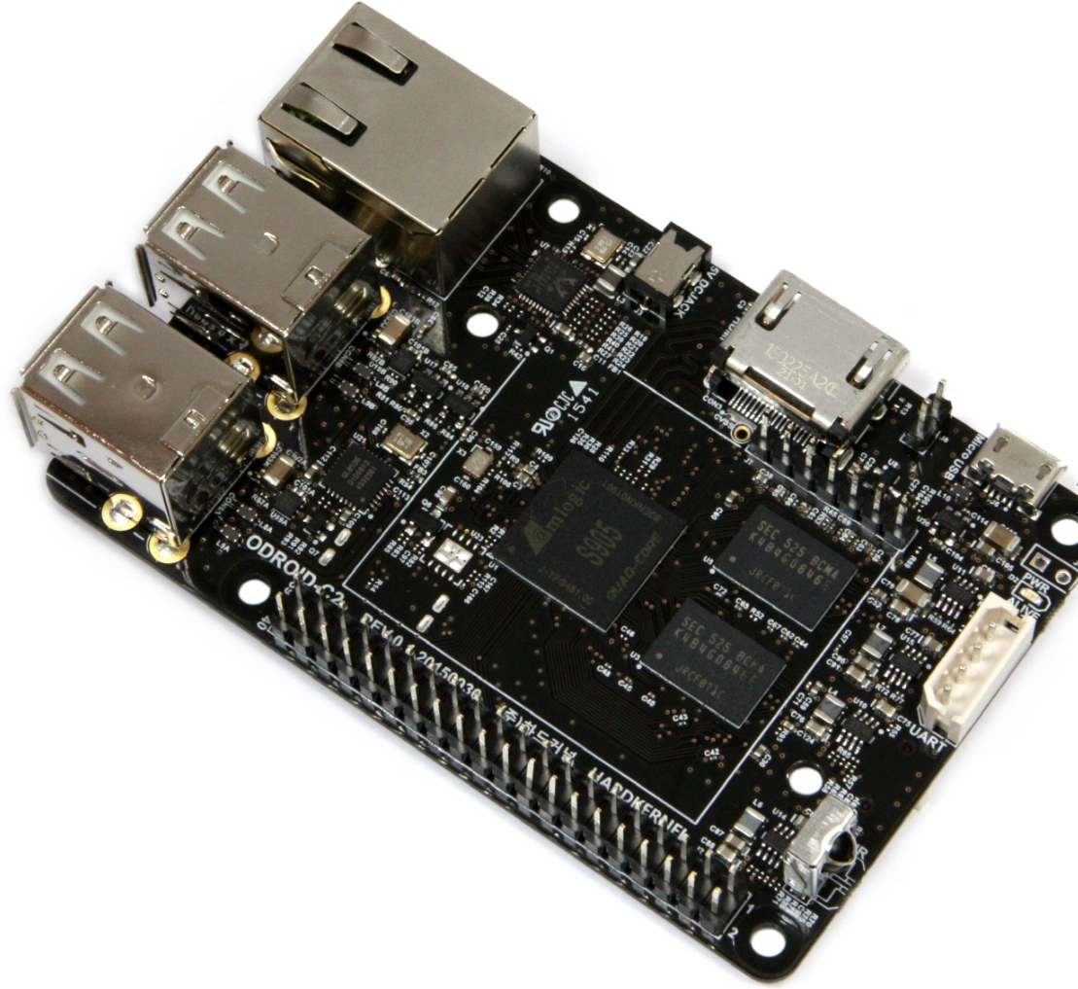
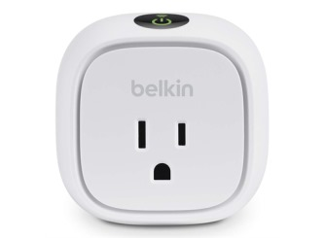
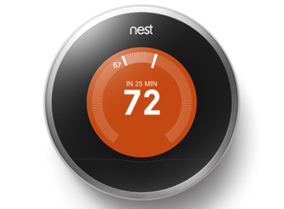
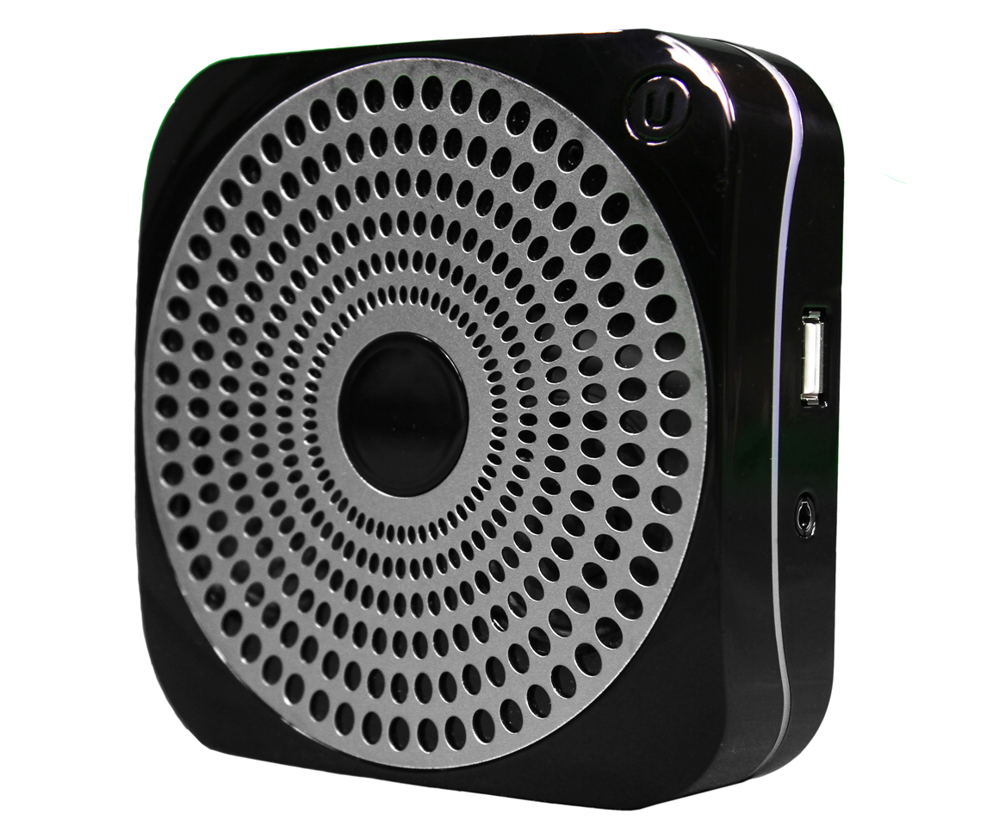
Initial Work: Connect and Monitor
PixStar Digital Photoframe
Sharx Security IP Camera
SmartSense Multi-sensor
Smartthings Hub
WiFi
Z-Wave
Gateway (Passive Monitor)
Belkin WeMo Switch
Ubi Smart Speaker
Nest Thermostat
Notes:
As before, we started with a simple question: What are these devices doing? Who are they talking to? (circa 2015)
We picked top few devices on amazon, tried to pick different manufacturers.
Thought this would be a lot harder than it turned out to be… (no encryption!)

Slide 3
Attack 1:
Identify Local IoT Devices

Slide 4


Attack Steps
Get local IP (via WebRTC SDP)
192.168.6.6
Notes:
More relax

Slide 5

Attack Steps
2. Find active local devices.
Scan local subnet on port 81, sending GET request (via Fetch API)
Measure response times (TCP RST vs. TCP timeout)
192.168.6.88
192.168.6.6
Notes:
More relax

Slide 6
Attack Steps
2. Find active local devices.
Scan local subnet on port 81, sending GET request (via Fetch API)
Measure response times (TCP RST vs. TCP timeout)
192.168.6.88
TCP SYN to port 81
192.168.6.6
TCP RST
Notes:
TCP RST is fast!
Timeout is slooowww

Slide 7
Attack Steps
2. Find active local devices.
Scan local subnet on port 81, sending GET request (via Fetch API)
Measure response times (TCP RST vs. TCP timeout)
192.168.6.88
192.168.6.6
TCP SYN to port 81
192.168.6.89
?
Notes:
TCP RST is fast!
Timeout is slooowww

Slide 8
Attack Steps
3. Identify IoT devices.
Send request for our GET endpoints to active IP addresses, using HTML5 <audio> element.
Use resulting MediaError message to infer resource availability (new side channel).
192.168.6.88
192.168.6.6
Notes:
More relax

Slide 9
Attack Steps
3. Identify IoT devices.
Send request for our GET endpoints to active IP addresses, using HTML5 <audio> element.
Use resulting MediaError message to infer resource availability (new side channel).
192.168.6.88
192.168.6.6
GET /setup.xml
Notes:
More relax

Slide 10

Attack Steps
3. Identify IoT devices.
Send request for our GET endpoints to active IP addresses, using HTML5 <audio> element.
Use resulting MediaError message to infer resource availability (new side channel).
If Exists: MEDIA_ERR_SRC_NOT_SUPPORTED “DEMUXER_ERROR_COULD_NOT_OPEN: FFmpegDemuxer: open context failed”
Else: MEDIA_ELEMENT_ERROR “Format error”
Notes:
Not supposed to be possible for X-origin request due to SOP (except images/CCS and passive resources), this is a new vuln

Slide 11

Attack Steps
3. Identify IoT devices.
Send request for our GET endpoints to active IP addresses, using HTML5 <audio> element.
Use resulting MediaError message to infer resource availability (new side channel).
If Exists: MEDIA_ERR_SRC_NOT_SUPPORTED “Failed to init decoder”
Else: MEDIA_ELEMENT_ERROR “Message 404: Not Found”
Notes:
More relax

Slide 12


Attack Steps
3. Identify IoT devices.
Send request for our GET endpoints to active IP addresses, using HTML5 <audio> element.
Use resulting MediaError message to infer resource availability (new side channel).
Safari: Fetches timed out
Edge: No MediaError error messages
(Attack 1 does not work)
Notes:
More relax

Slide 13
Implications
Side-channel sidestepping SOP (Chrome bug bounty)
Attack stepping stone
Privacy leaks (e.g., network fingerprinting)
Notes:
More relax

Slide 14
Attack 2:
Access & Control Local Devices

Slide 15
DNS Rebinding
Attack fully bypassing SOP
(D. Dean, E. Felten, and D. Wallach, IEEE S&P 1996)
Requires a web attacker (controls malicious domain + webserver) also controlling domain’s authoritative DNS nameserver
Notes:
More relax

Slide 16
Attack Steps
192.168.6.88
Notes:
More relax

Slide 17


Attack Steps
Victim visits attacker.com, queries malicious nameserver for attacker.com. Return web server IP w/ short TTL.
Authoritative DNS Server
Attacker.com Web Server
6.6.6.6
GET / HTTP/1.1
ANSWER SECTION:
Attacker.com 1 IN A 6.6.6.6
192.168.6.88
HTTP 200
Notes:
More relax

Slide 18
Attack Steps
2. Attacker website loads another resource test.
Authoritative DNS Server
Attacker.com Web Server
6.6.6.6
192.168.6.88
Notes:
More relax

Slide 19
Attack Steps
3. If attacker.com’s DNS A record is cached, test is directly retrieved. If so, wait and retry...
Authoritative DNS Server
Attacker.com Web Server
6.6.6.6
GET /test HTTP/1.1
192.168.6.88
HTTP 200
Notes:
More relax

Slide 20
Attack Steps
4. If attacker.com’s DNS A record is not cached, browser queries malicious nameserver again. Now return target IP w/ large TTL.
Authoritative DNS Server
Attacker.com Web Server
6.6.6.6
ANSWER SECTION:
Attacker.com 300 IN A 192.168.6.88
192.168.6.88
Notes:
More relax

Slide 21
Attack Steps
5. This time, retrieving test fails. But attacker.com is now rebound to the target IP, and can make direct requests.
Authoritative DNS Server
Attacker.com Web Server
6.6.6.6
192.168.6.88
GET /test HTTP/1.1
HTTP 404
Notes:
More relax

Slide 22
Attack Steps
5. This time, retrieving test fails. But attacker.com is now rebound to the target IP, and can make direct requests.
Authoritative DNS Server
Attacker.com Web Server
6.6.6.6
192.168.6.88
GET /setup.xml HTTP/1.1
HTTP 200
Notes:
More relax

Slide 23

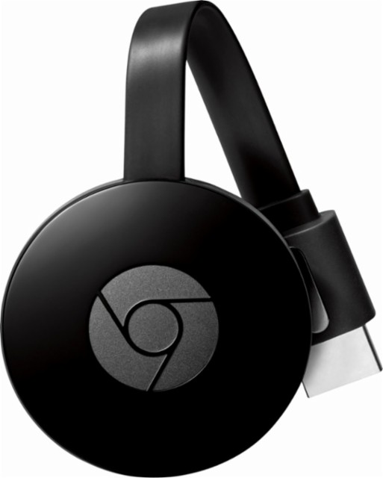
Attack on Devices
Google Home/Chromecast
Potential attacks:
Play arbitrary Youtube videos on Chromecast
Reboot Chromecast/Home
Scan for WiFi networks and return information
Notes:
More relax

Slide 24
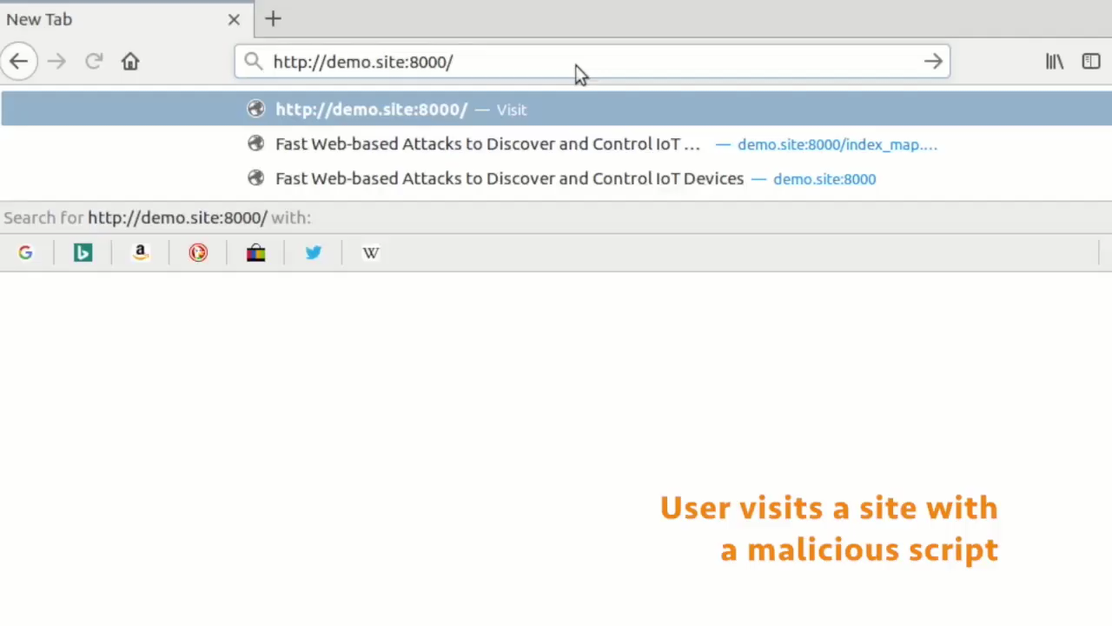
Fast Web-based Attacks to Discover and Control IoT Devices Gunes Acar, Danny Y. Huang, Frank Li, Arvind Narayanan, and Nick Feamster. ACM SIGCOMM Workshop on IoT Security and Privacy. 2018.
Notes:
Many of these devices interface with their smartphone app companion through a (simple, insecure, unauthenticated) web server.
This means that…
Classical web-based attacks also work on many of these devices!

Slide 25
Implications
Attacker control of IoT device actions
Exploiting IoT device vulnerabilities for full compromise
Privacy leaks (e.g., extensive device fingerprinting or user profiling)
Notes:
More relax

Slide 26
Moving Forward...
Low barrier to attacks on local IoT devices via malicious websites.
Need defenses that protect against lateral attacks.

Slide 27
Privacy Challenges

Slide 28
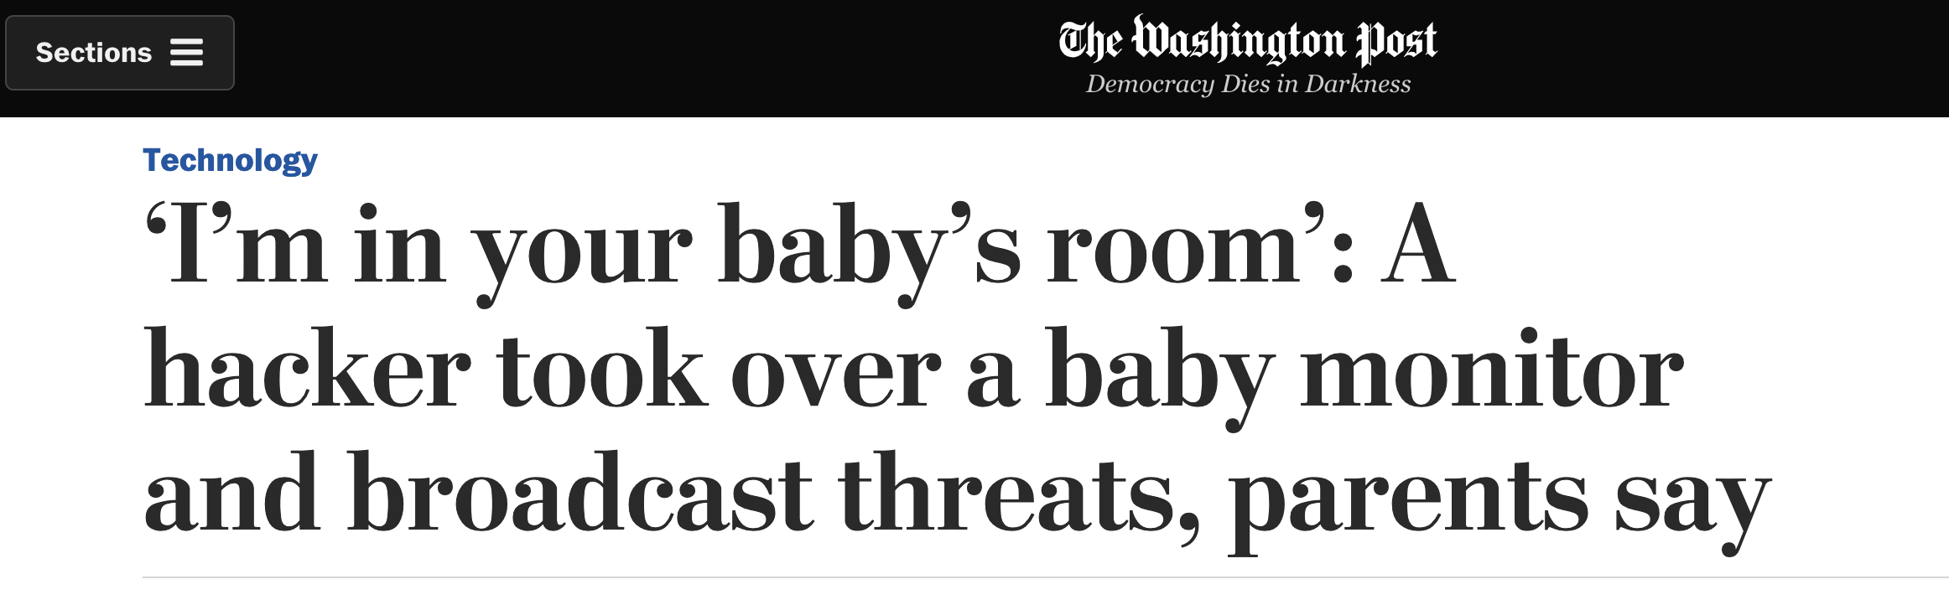
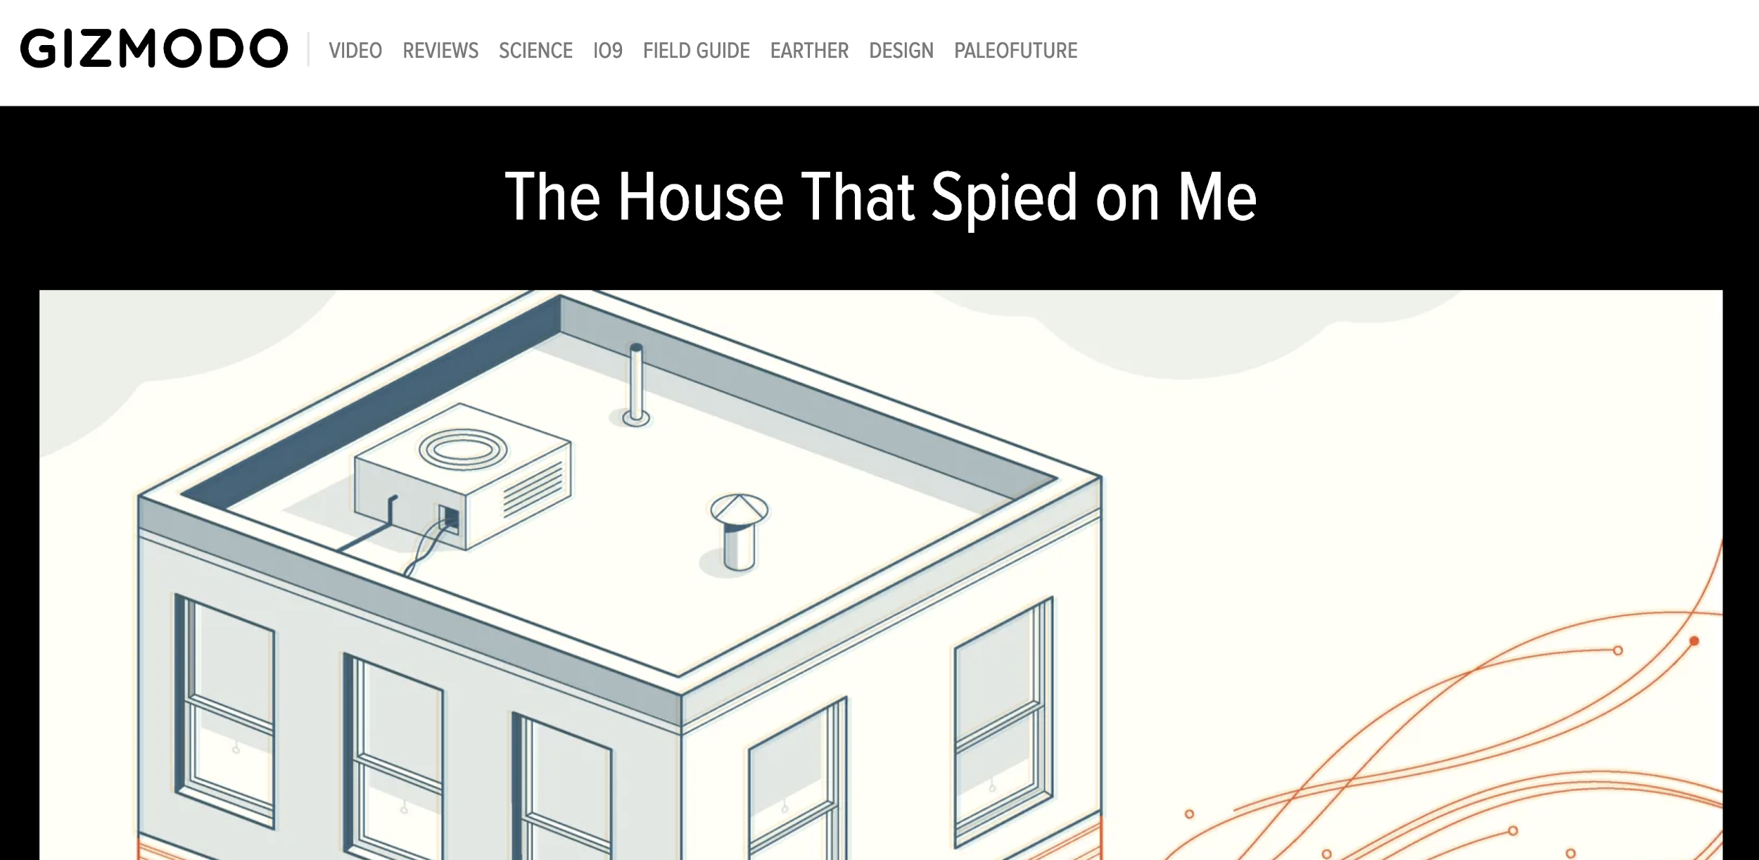
Difficult to study security/privacy systematically
Anecdotal reports
Large-scale studies
Internet exposed only
Home/enterprise networks: proprietary data

Slide 29
What is IoT Inspector
Open-source desktop application
that passively monitors smart home networks
Benefits to IoT users
Easy to install and use
Visualization of potential security & privacy issues
Benefits to IoT researchers
Non-proprietary dataset
IoT traffic in real homes

Slide 30
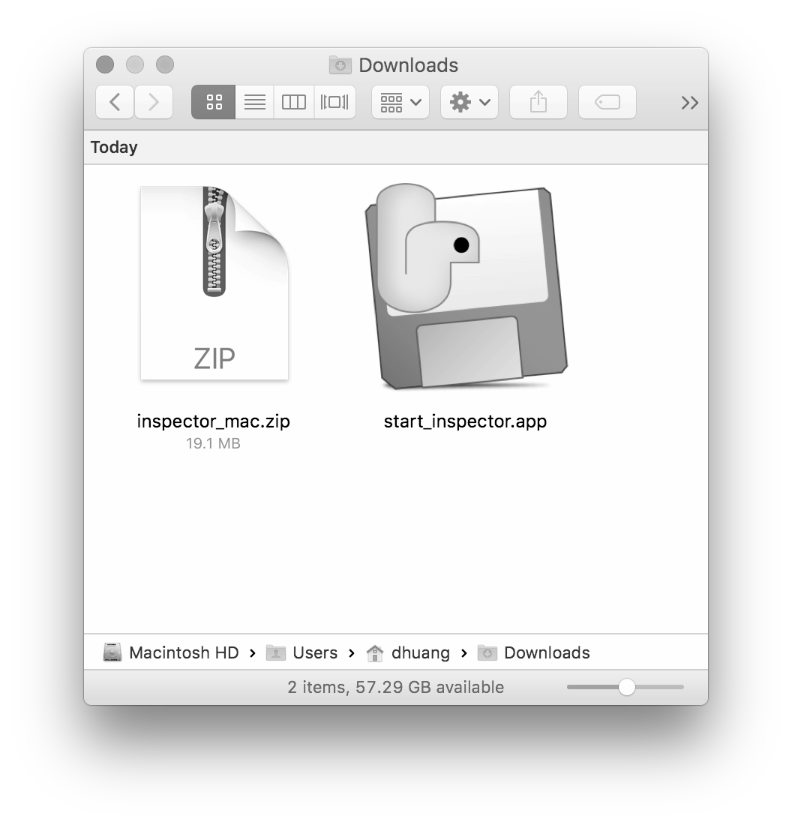
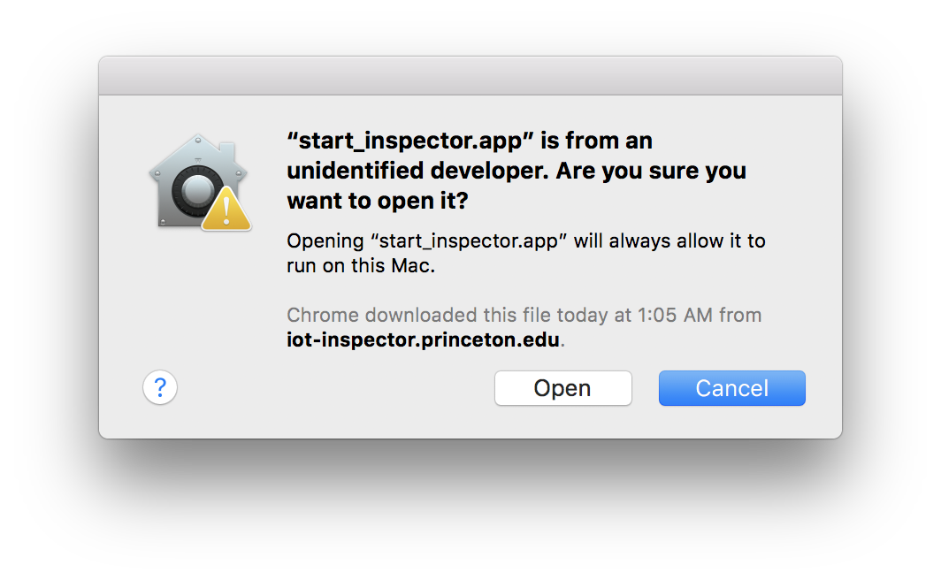
Download and run IoT Inspector

Slide 31
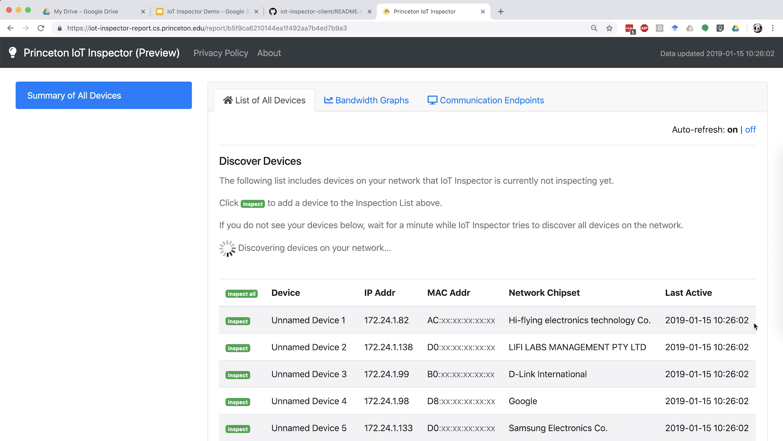
Download and run IoT Inspector

Slide 32
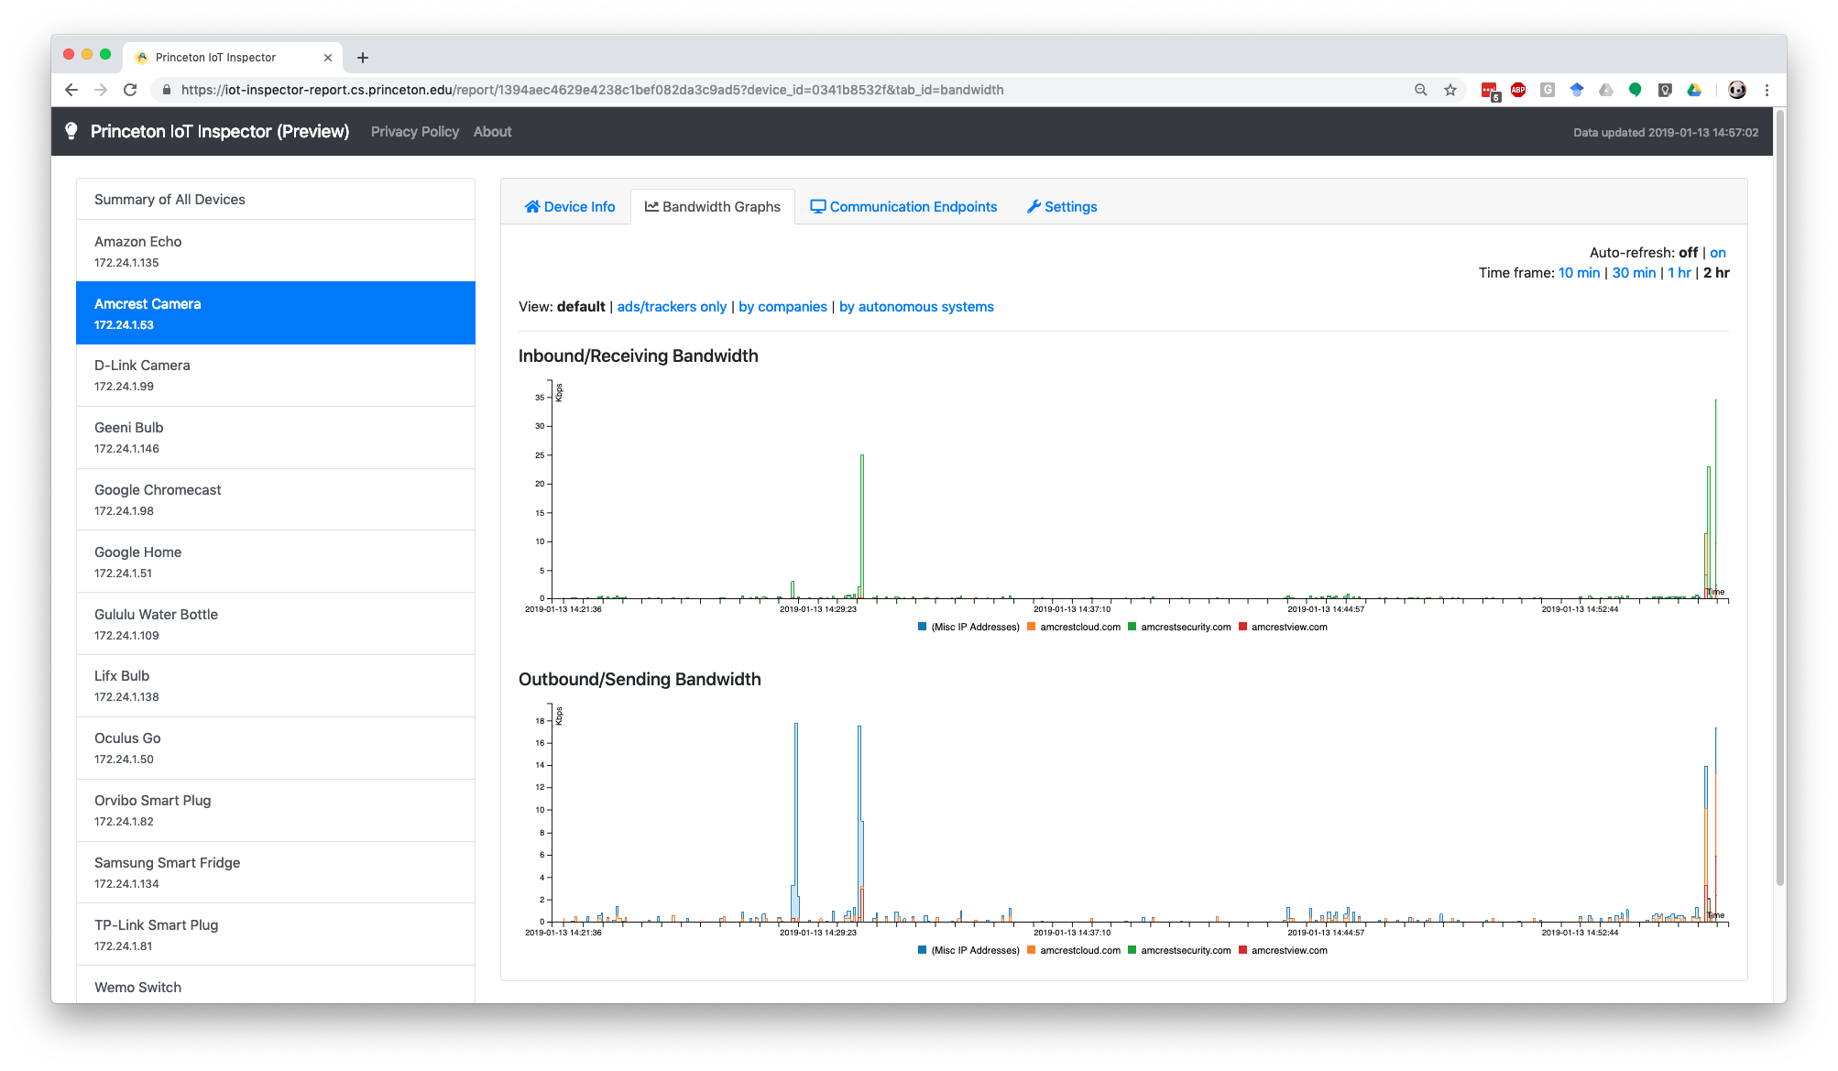
Bandwidth graph for each device

Slide 33
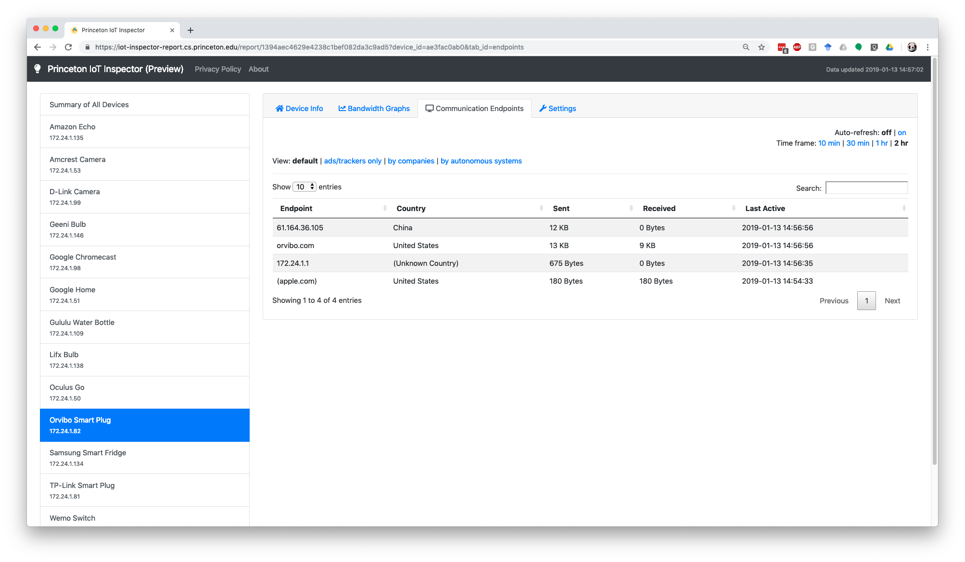
Bandwidth graph for each device

Slide 34
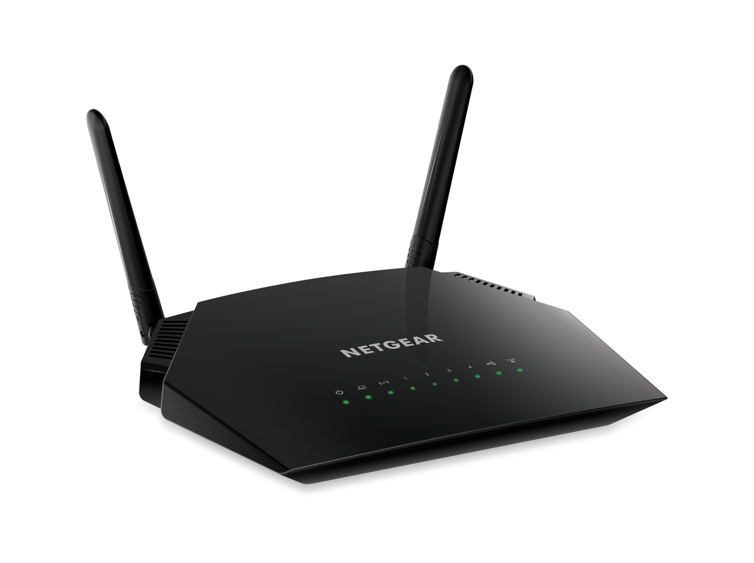
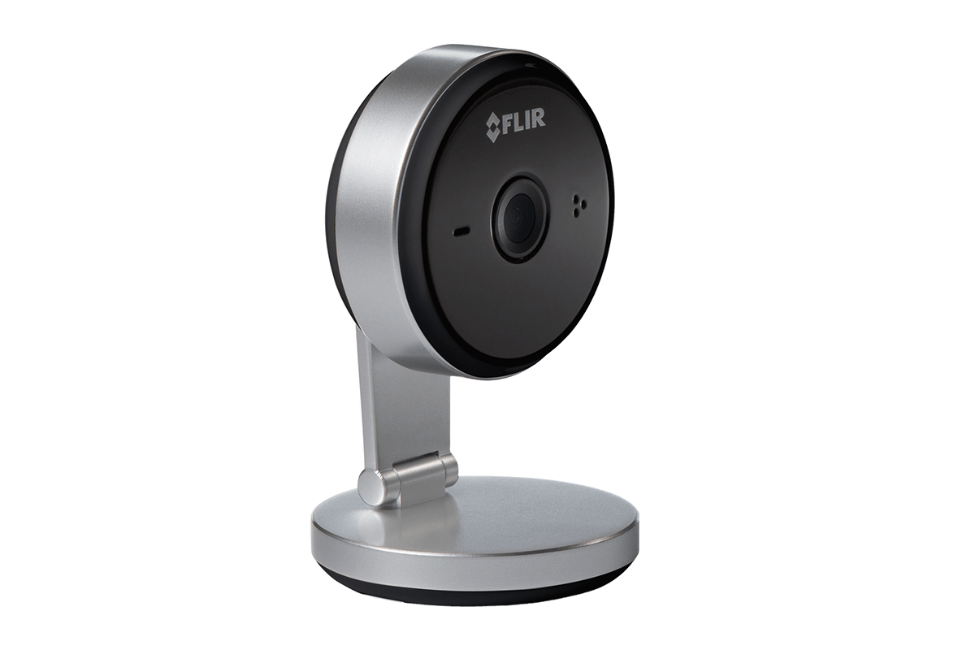

IoT Inspector works through ARP-spoofing
Internet
Hi camera: I’m router!
Hi router: I’m camera!
IoT Inspector

Slide 35
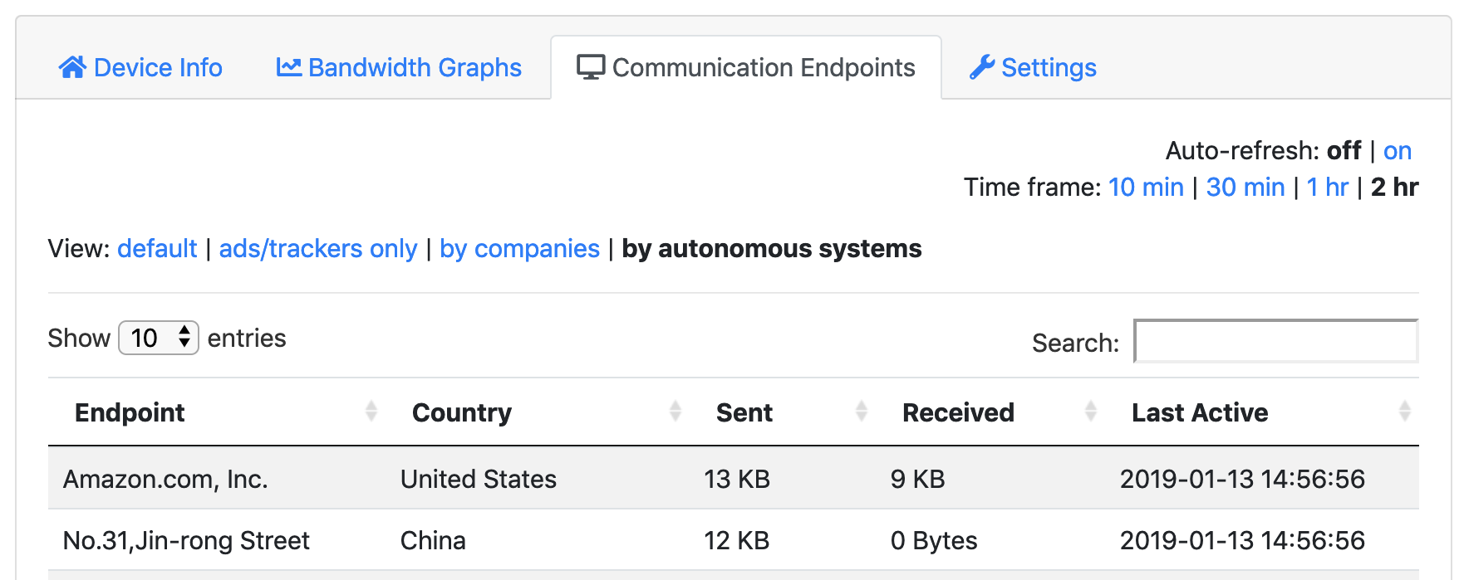
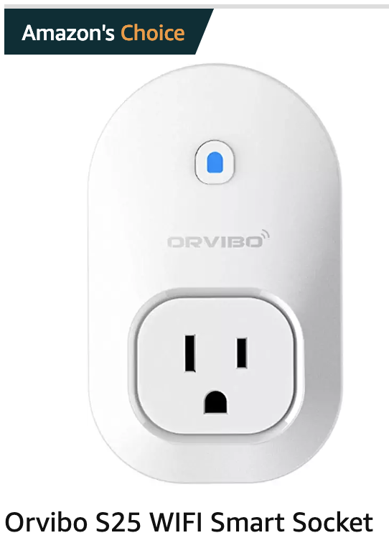
Insight: IoTs communicate with whom
Notes:
Again, first page on Amazon for “wifi smart socket”

Slide 36
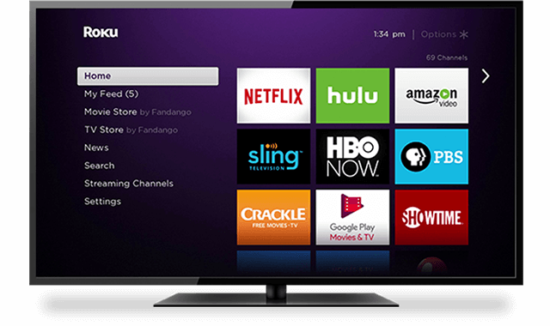

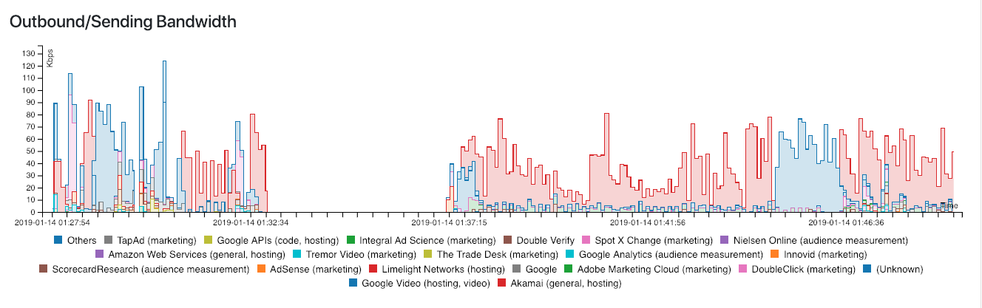
Insight: trackers/ads on Roku TV
Notes:
Roku: 30% of connected TVs; followed by 27% Amazon
https://iot-inspector-report.cs.princeton.edu/report/6aae51c55c2246721dac4b5b44743f2b

Slide 37

Insight: trackers/ads on Roku TV
Notes:
Roku: 30% of connected TVs; followed by 27% Amazon
https://iot-inspector-report.cs.princeton.edu/report/6aae51c55c2246721dac4b5b44743f2b

Slide 38
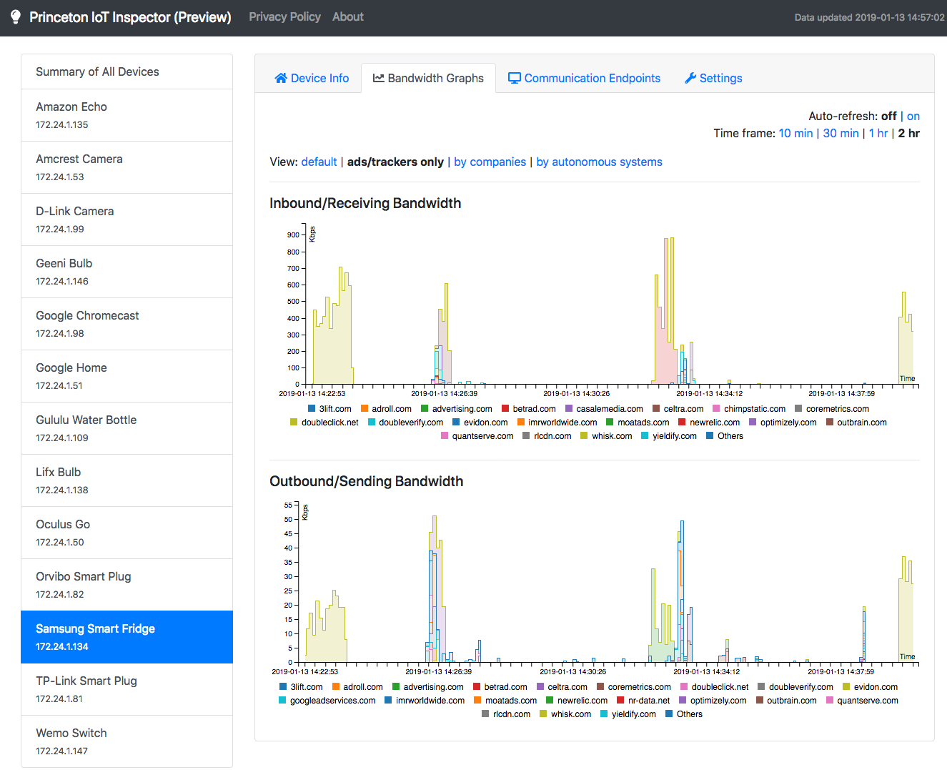
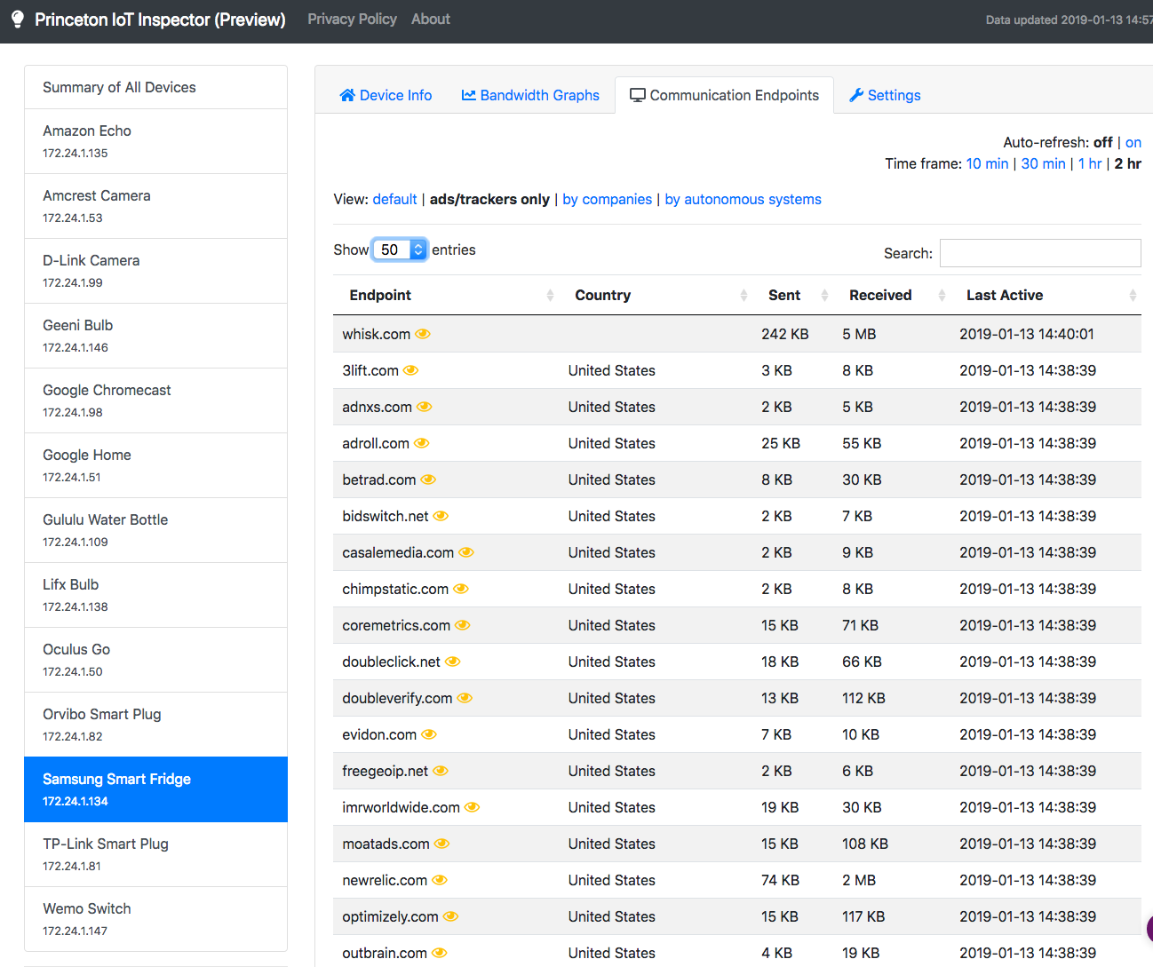
Notes:
Screenshots of your Samsung fridge, which actually talks to a whole bunch of trackers, including Nielsen!

Slide 39
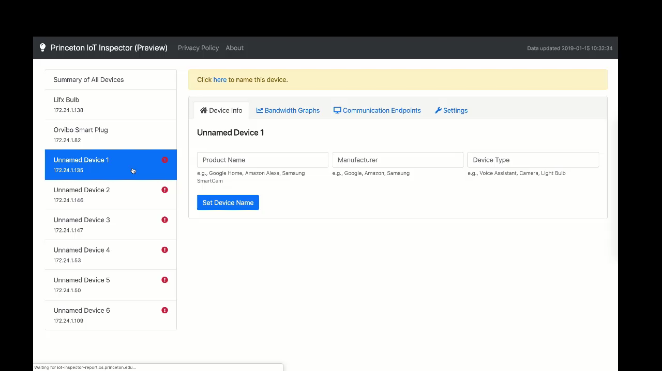

Slide 40


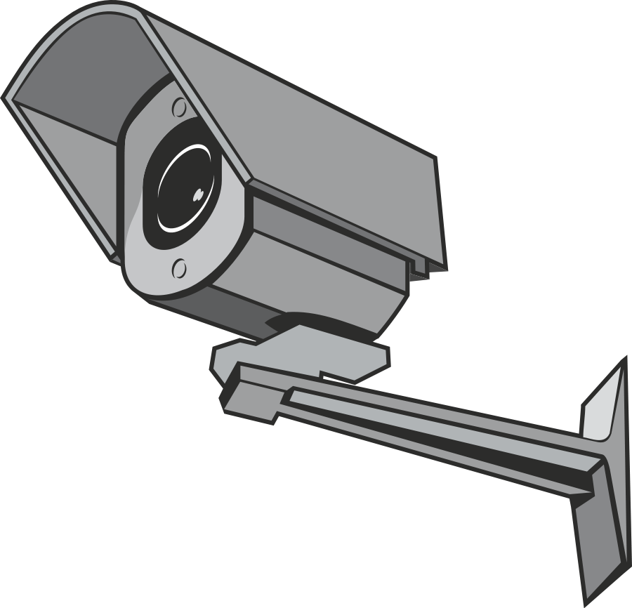
Summary of insights
Privacy
Tracking/ads on TVs
Data aggregators on IoTs
Security
Anomaly detection
TLS (encryption) analysis, e.g.,
TLS 1.0: Samsung Smart Cam Amazon Prime Video on Roku
Insecure cipher suites: D-Link camera: 13 Amcrest Camera: 21

Slide 41
Summary
Security challenges in smart homes due to lack of isolation of devices from one another
Web-based discovery and control
Privacy challenges due to pervasive tracking, lack of encryption

Slide 42
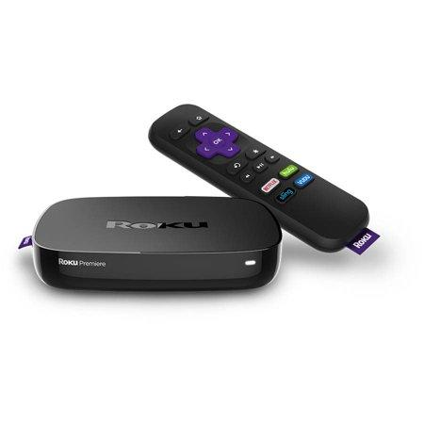
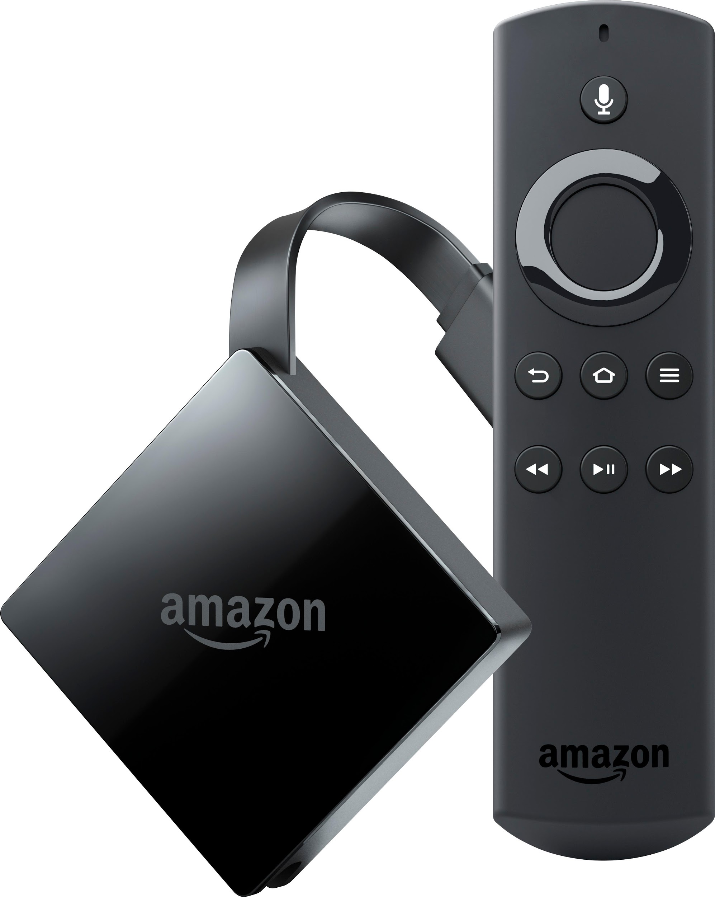
Streaming devices
Notes:
Fix picture
Mention price - much cheaper than smart tv or PC
These give you access to over X apps on Roku and Amazon

Slide 43
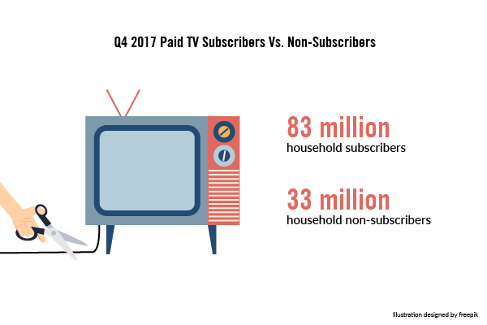
Cordcutting
Two primary options
Over-the-air HDTV
HDTV antenna
Streaming
PC
Streaming devices
Notes:
Motivate, give numbers why this is an important problem
Why we chose these platforms
Add reason for crawler - motivate better
Add visuals - pictures connected to TV
Does anyone recognize these? Show picture of two devices then lead into cord cutting

Slide 44
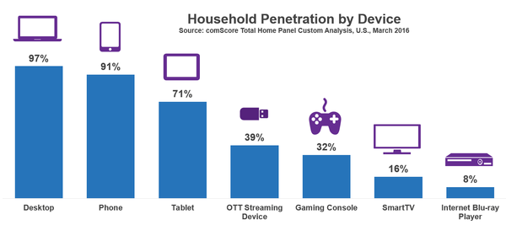
Cordcutting
Notes:
Motivate, give numbers why this is an important problem
Why we chose these platforms
Add reason for crawler - motivate better
Add visuals - pictures connected to TV

Slide 45
Cordcutting
Streaming devices introduce new privacy concerns
Open ecosystem may allow significantly more third parties
Streaming devices can report viewing history and other identifiers
Third party apps can potentially include their own ad libraries
Notes:
Mention this is the first study on OTT

Slide 46
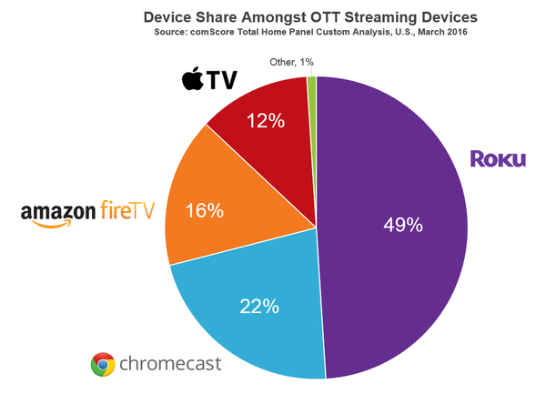
Cordcutting
Notes:
Motivate, give numbers why this is an important problem
Why we chose these platforms
Add reason for crawler - motivate better
Add visuals - pictures connected to TV

Slide 47

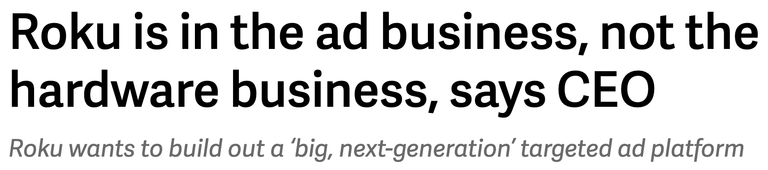
Hidden data flows

Slide 48
Research Questions
Which parties do streaming devices contact?
Tracker ecosystems
Information being shared
Effectiveness of the platform privacy options
Notes:
Contrast studies from web and mobile to this study

Slide 49
Results
Most channels are contacting known trackers
89% of Amazon Fire TV channels
69% of Roku Channels
Platform privacy options largely ineffective
Channels leak video titles to trackers
Notes:
Add bullet point for every research questions
Contrast studies from web and mobile to this study
Move up questions from later slide - Rename as research questions
Add title leak detections

Slide 50


Challenges
Difficult to automate input
Web & mobile: known tools with feedback
Streaming devices: no known tools, no feedback
Difficult to decrypt traffic to see content flows
Web & mobile: add self signed certificate to certificate store
Streaming devices: hard to change certificate store
Notes:
Selenium, Monkey
Mention what the plain text gives incase someone doesn’t know.
We need to decrypt to get the content that is being sent to these parties
Make sure to say 2. right

Slide 51
Overview of method
1. Develop crawler for streaming devices
Simulate a user interacting with channels
Intercept traffic the streaming device generates
2. Collect data on Amazon and Roku platforms
3. Analyze data
Notes:
Add more detail into how the channel lists are created
Also explain the intention of the crawler - We wanted to study these channels at scale and our goal is to launch an app, simulate a user’s behaviour and get to a video.

Slide 52
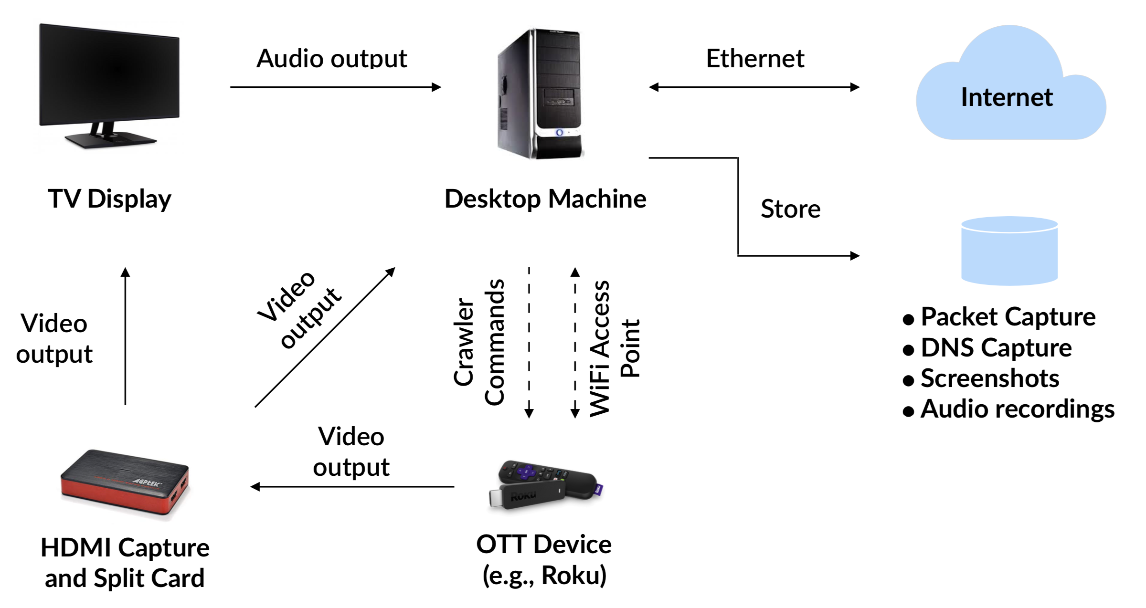
System design of crawler

Slide 53
System design of crawler

Slide 54
System design of crawler
Notes:
Don’t mention HDCP/adb - Make clear that mitmproxy is running on the desktop

Slide 55
System design of crawler
Notes:
Change TV crawler to OTT consistently

Slide 56
Intercepting Traffic
Roku
Best-effort interception
Proxy traffic between the streaming device and the internet
Sign TLS traffic with self signed cert
Amazon

Slide 57
Intercepting Traffic
Challenges
Channel may validate certs for some or all connections
Failed validation => cannot launch channel
Solution
Extends original MITM-proxy
Warm-up; remember failed connections

Slide 58
Best-effort traffic interception
Challenges
Channel may validate certs for some or all connections
Failed validation => cannot launch channel
Solution
Extends original mitmproxy
Warm-up; remember failed connections
Notes:
Add graph with warm up crawls to make the presentation a bit more visual

Slide 59
Intercepting Traffic
Roku
Best-effort MITM-proxy
Amazon

Slide 60
Intercepting Traffic
Roku
Best-effort interception
Amazon
Rooted (k4y0z method¹); changed certificate
Frida to bypass channel-level pinning
1. https://forum.xda-developers.com/fire-tv/development/unlock-fire-tv-stick-2nd-gen-tank

Slide 61
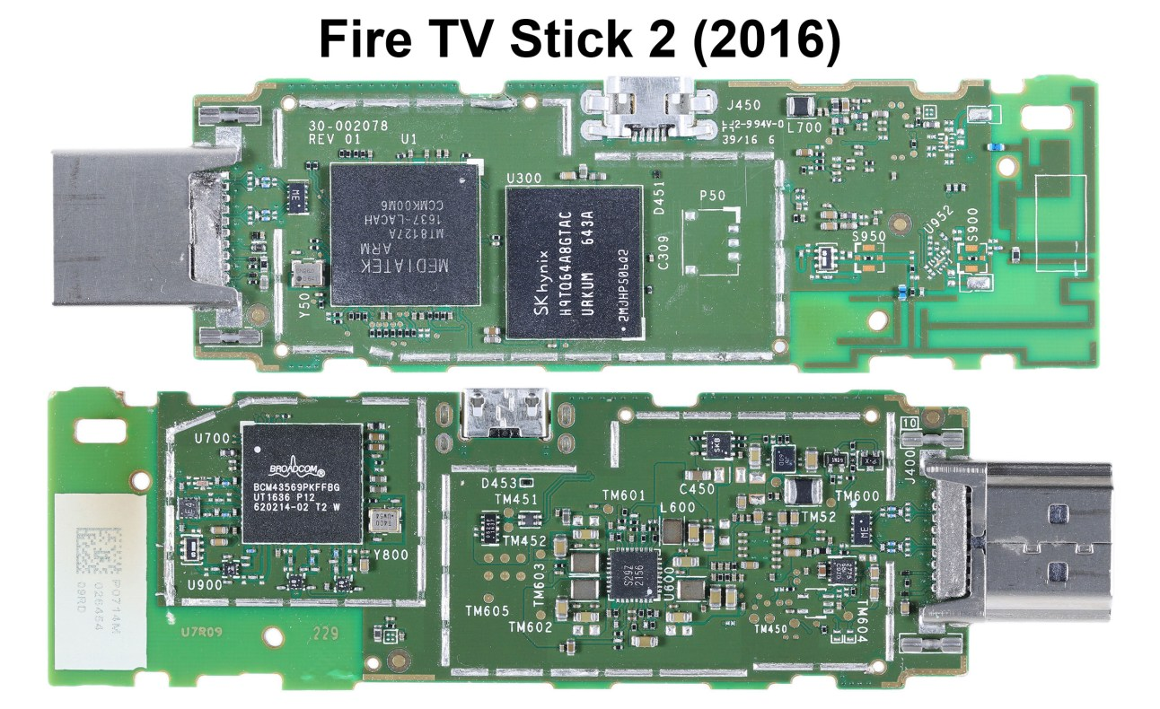
Rooting FireTV
Install Team Win Recovery Project (TWRP)
Short CLK to GND
Replace bootloader with unlocked fastboot version
Use TWRP
Flash super user binary

Slide 62
Intercepting Traffic
Roku
Best-effort MITM-proxy
Amazon
Rooted; changed certificate
Frida to bypass channel-level pinning

Slide 63
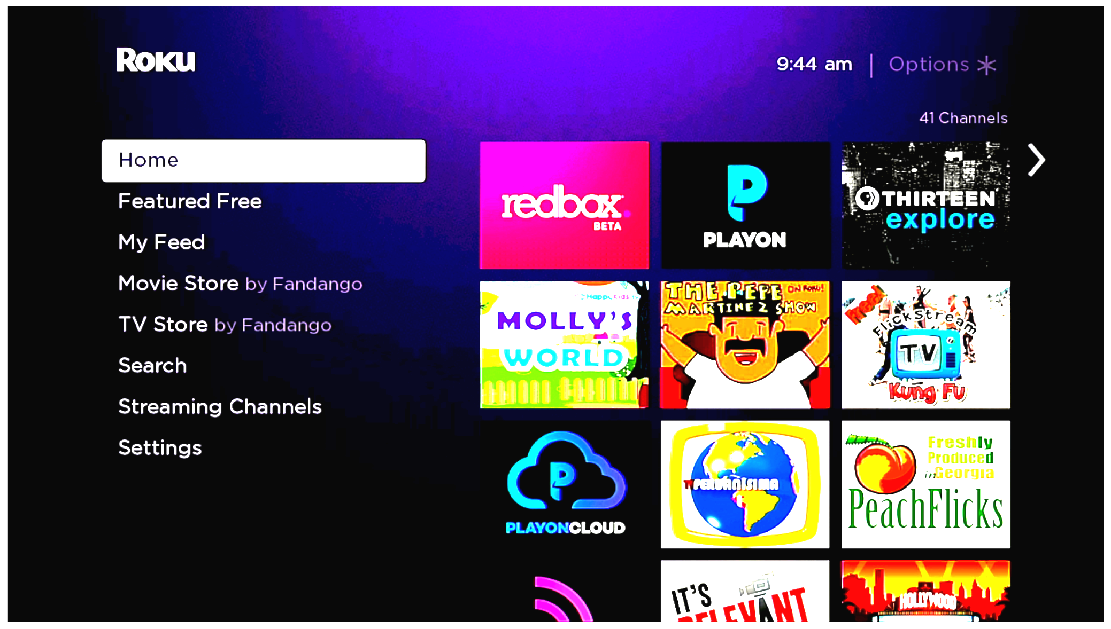
Automatically interacting with channels
1. Install channel
2. Launch channel
3. Navigate to video
4. Play video
5. Uninstall channel
Notes:
Add table of crawls then say going to present subset

Slide 64
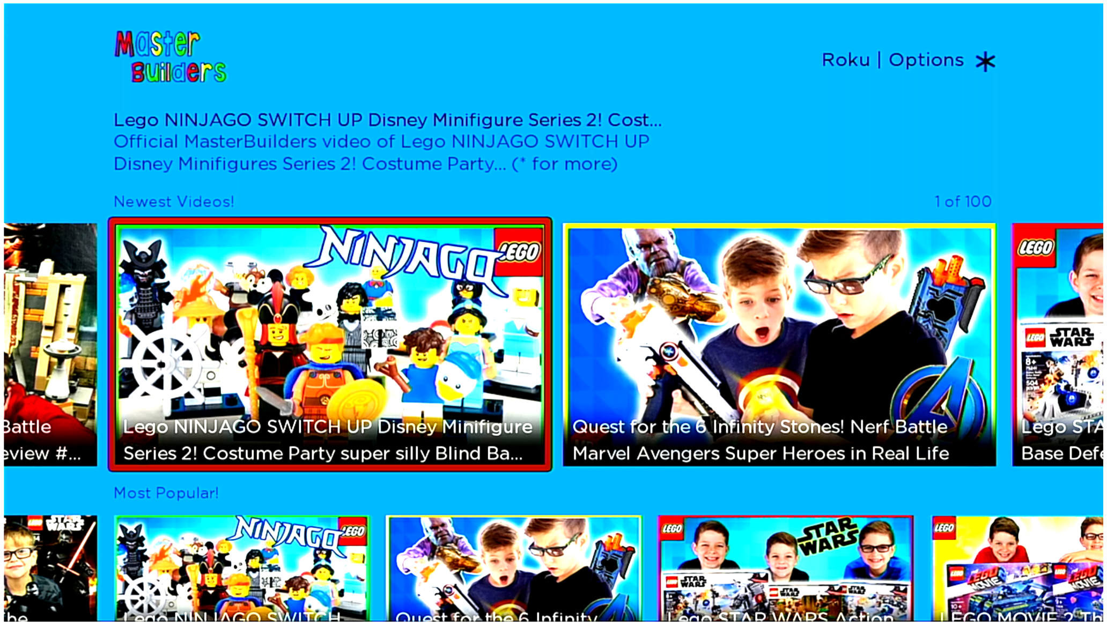
Automatically interacting with channels
1. Install channel
2. Launch channel
3. Navigate to video
4. Play video
5. Uninstall channel
Notes:
Add table of crawls then say going to present subset

Slide 65
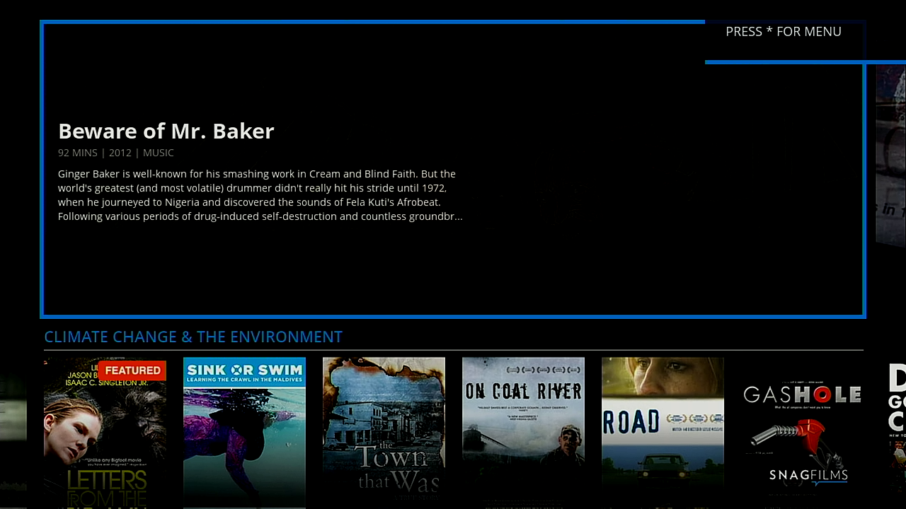
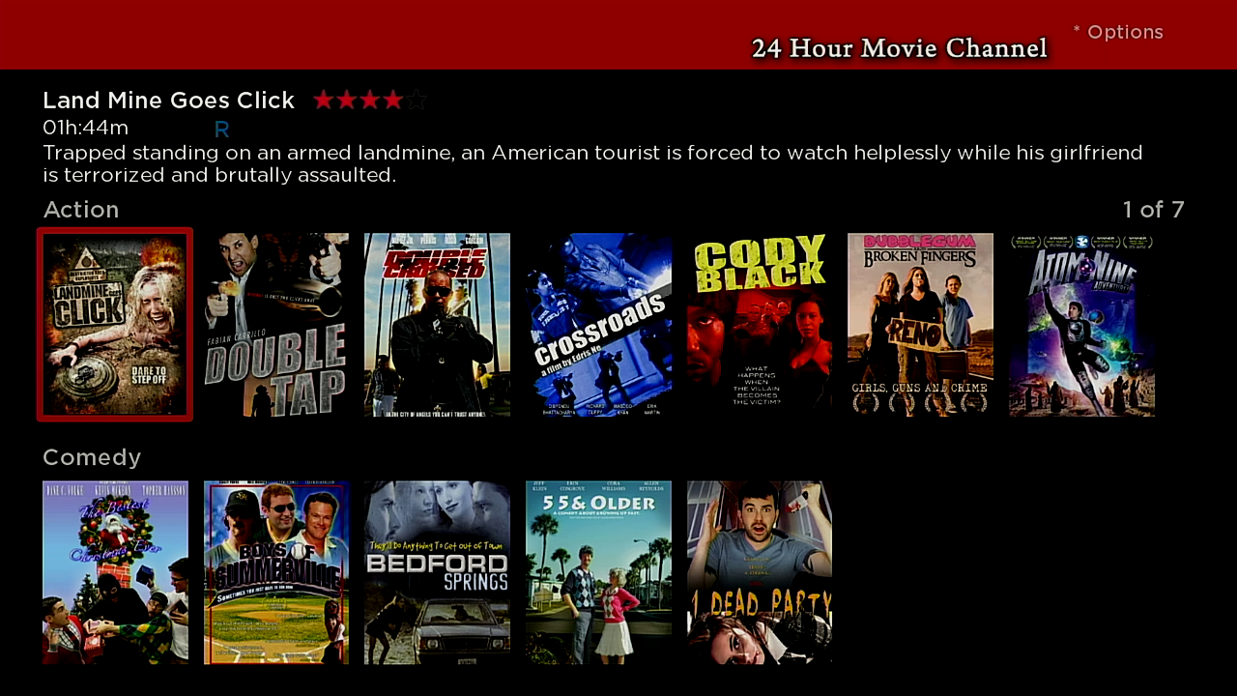
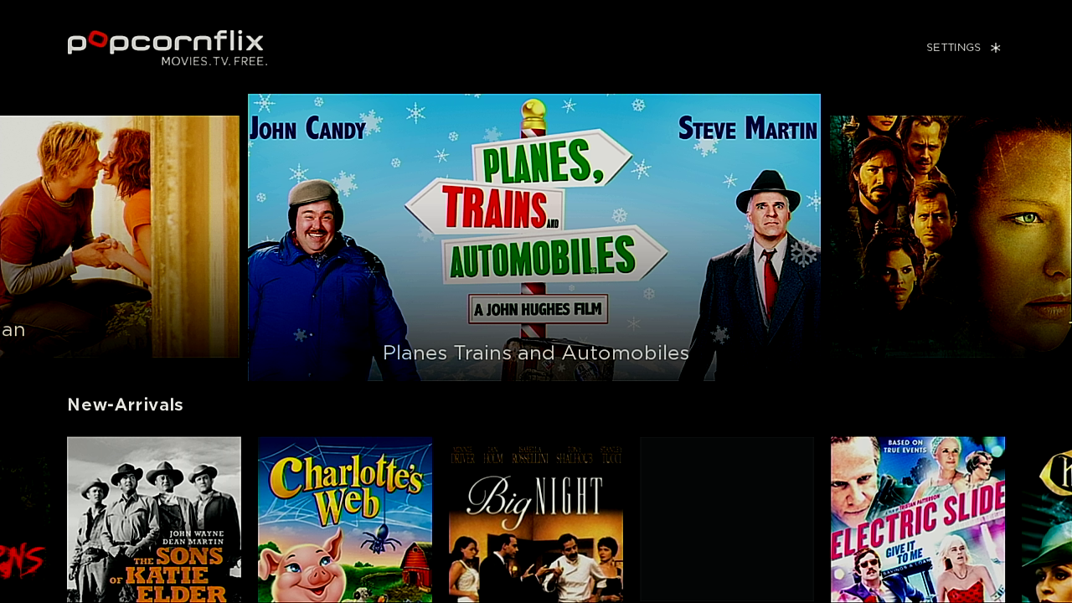
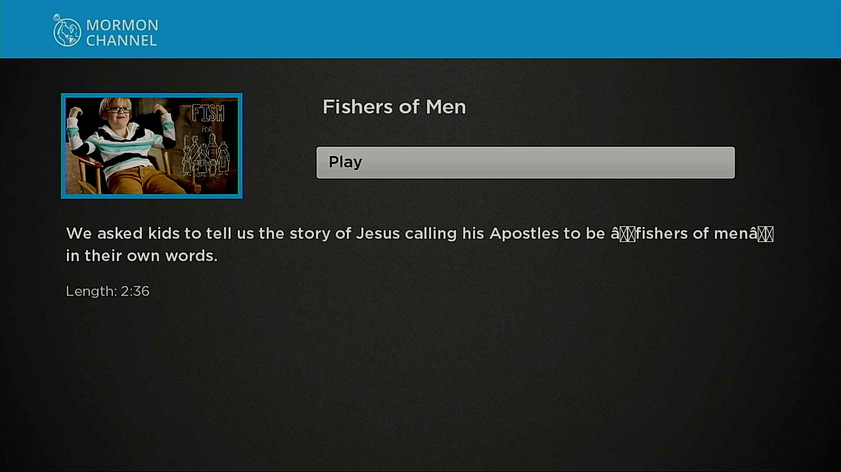
Automatically interacting with channels
1. Install channel
2. Launch channel
3. Navigate to video
4. Play video
5. Uninstall channel

Slide 66
Automatically interacting with channels
1. Install channel
2. Launch channel
3. Navigate to video
4. Play video
5. Uninstall channel
Common key sequences:
[OK, OK, OK]
[Down, OK, OK] [OK, OK, Down, OK, Down, OK]

Slide 67
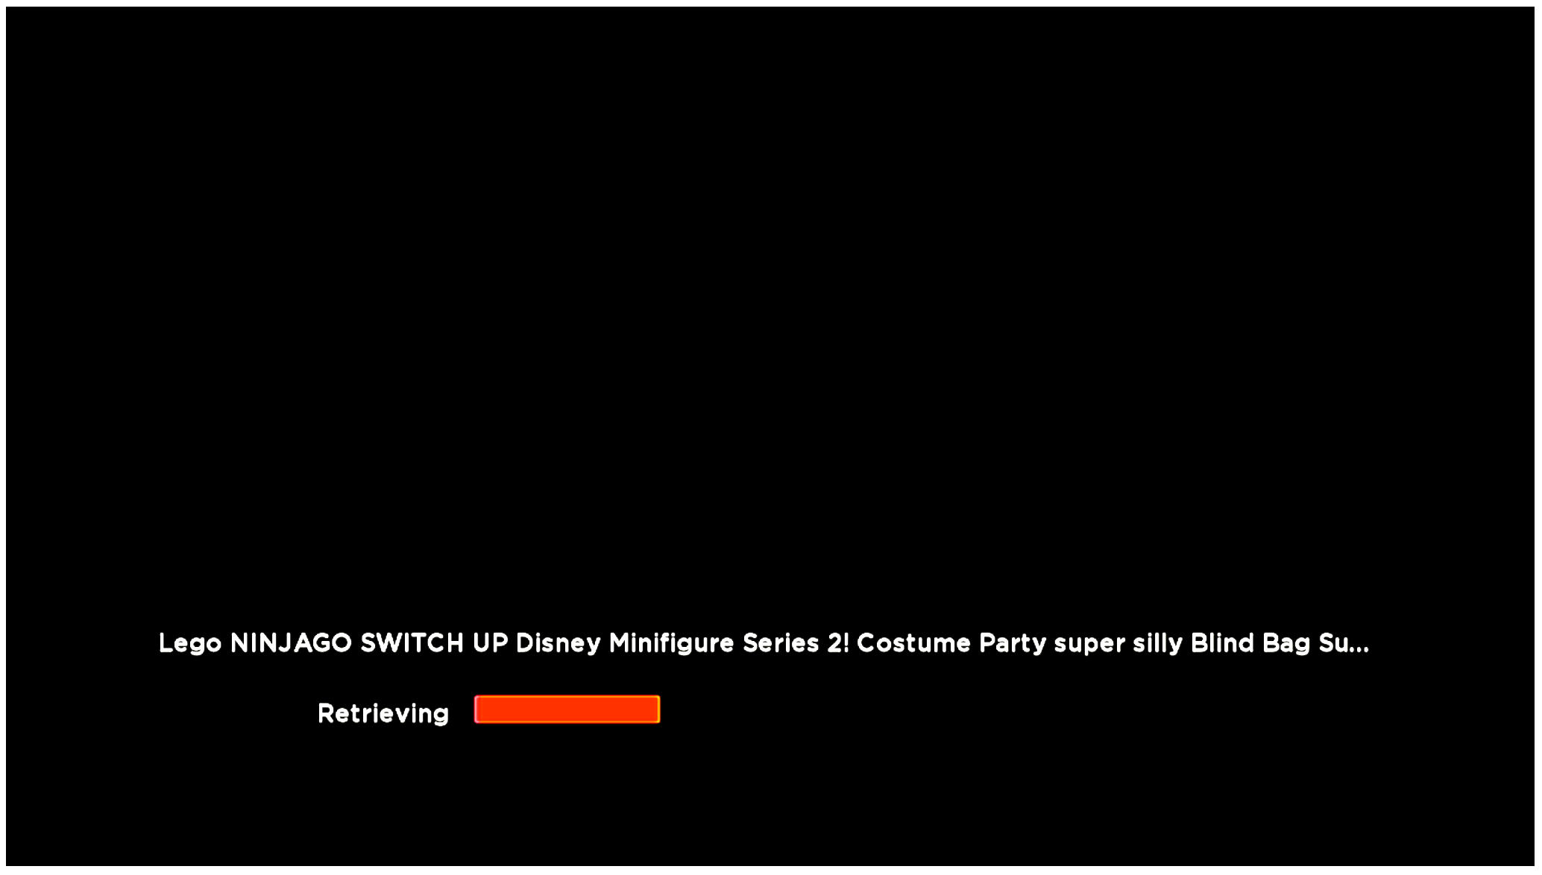
Automatically interacting with channels
1. Install channel
2. Launch channel
3. Navigate to video
4. Play video
5. Uninstall channel
Notes:
Add table of crawls then say going to present subset

Slide 68
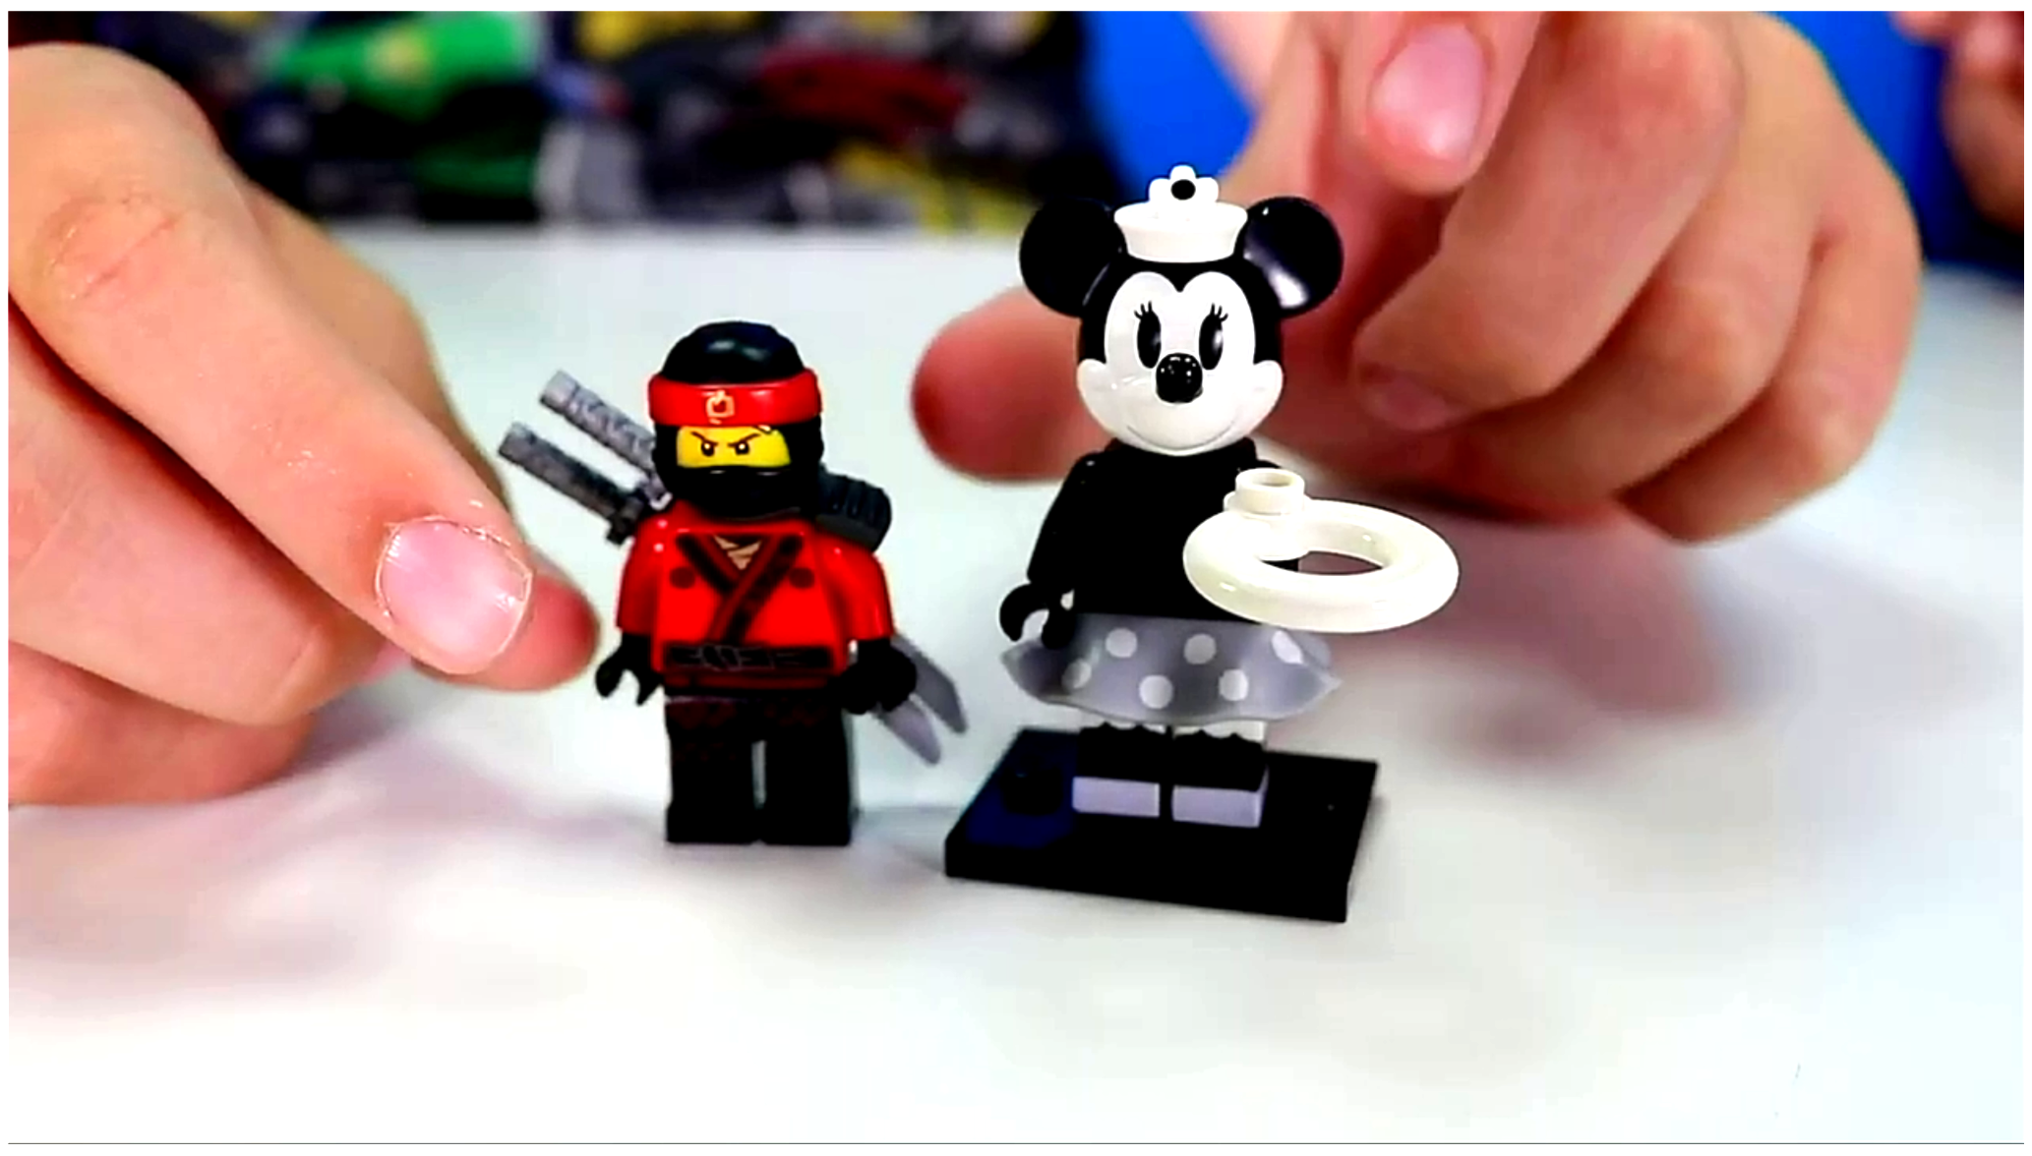
Automatically interacting with channels
1. Install channel
2. Launch channel
3. Navigate to video
4. Play video
5. Uninstall channel
Notes:
Add table of crawls then say going to present subset

Slide 69

Automatically interacting with channels
1. Install channel
2. Launch channel
3. Navigate to video
4. Play video
5. Uninstall channel
Notes:
Add table of crawls then say going to present subset

Slide 70
Automatically interacting with channels
1. Install channel
2. Launch channel
3. Navigate to video
4. Play video
5. Uninstall channel
Audio detection
Videos on 62% Roku, 51% Amazon
Correct detection: 144 / 150 (96%)

Slide 71
Automatically interacting with channels
1. Install channel
2. Launch channel
3. Navigate to video
4. Play video
5. Uninstall channel
Audio detection
Videos on 62% Roku, 51% Amazon
Correct detection: 144 / 150 (96%)
Fast forward

Slide 72
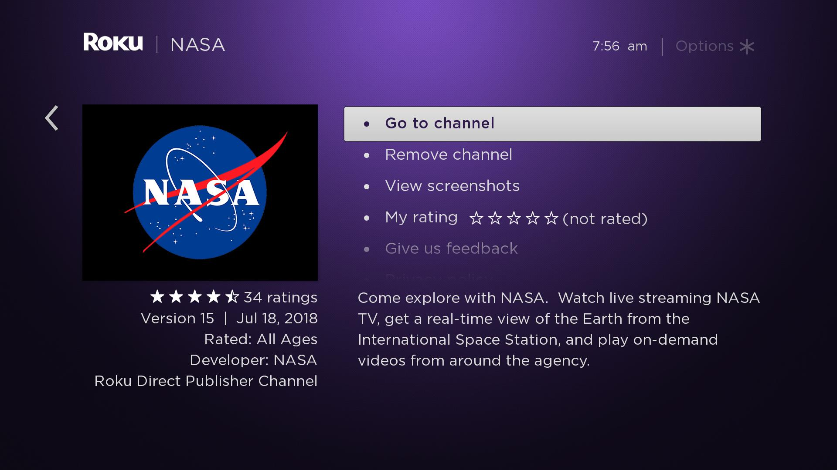
Automatically interacting with channels
1. Install channel
2. Launch channel
3. Navigate to video
4. Play video
5. Uninstall channel
Notes:
Add table of crawls then say going to present subset

Slide 73

Notes:
Add more detail into how the channel lists are created
Explain the intention of the crawler - We wanted to study these channels at scale and our goal is to launch an app, simulate a user’s behaviour and get to a video.

Slide 74
Overview of method
1. Develop crawler for streaming devices
2. Collect data on Amazon and Roku platforms
Create channel lists
Crawl channels
Test platform privacy options
3. Analyze data
Notes:
Add more detail into how the channel lists are created
Also explain the intention of the crawler - We wanted to study these channels at scale and our goal is to launch an app, simulate a user’s behaviour and get to a video.

Slide 75
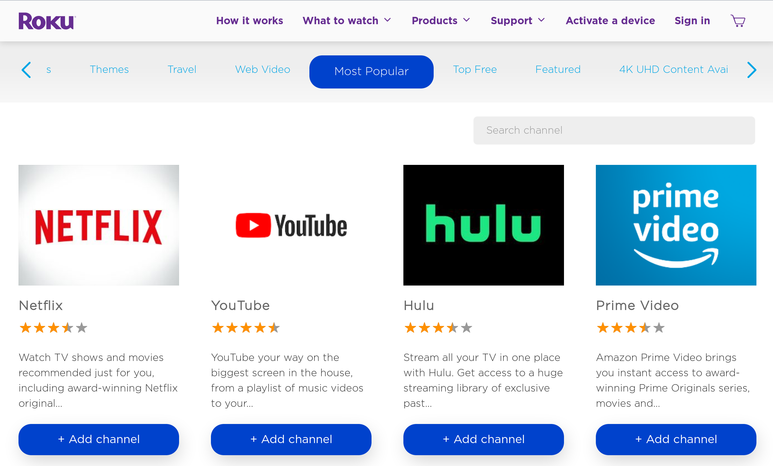
Channel lists
Generated from vendor channel stores
Multiple channel lists used in paper
Notes:
Add more detail into how the channel lists are created
Explain the intention of the crawler - We wanted to study these channels at scale and our goal is to launch an app, simulate a user’s behaviour and get to a video.

Slide 76
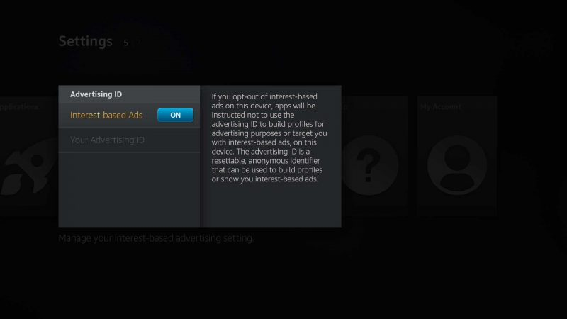
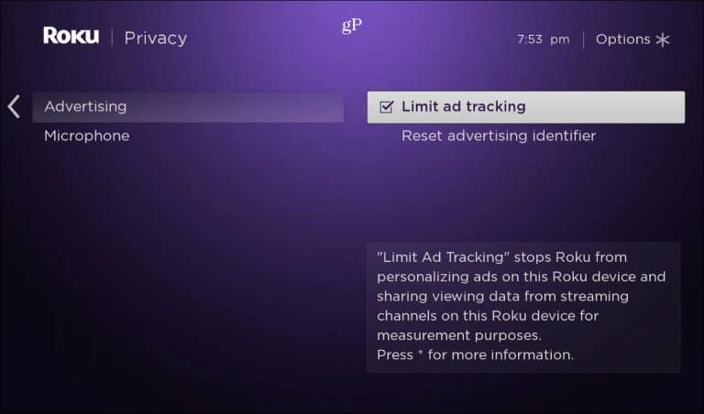
Channel lists
Channel lists used in presentation
Top 1000 channels
Top 100 channels
Privacy options enabled
Privacy options disabled
Notes:
Limit ad tracking on Amazon, Limit on Roku this is a similar concept to Do-Not-Track.
Okay i’ve presented some pretty nasty tracking options to but it turns out that on these platforms they offer a options etc…. Etc.
Do not track is ineffective nothing users can do…. We have long term impact through regulation. There’s very limited thing pretty much users can do in the near term to protect themselves
Pihole is effective to some extent

Slide 77
Overview of method
1. Develop crawler for streaming devices
2. Collect data on Amazon and Roku platforms
3. Analyze data
Trackers
Identifiers
Video titles
Notes:
Add more detail into how the channel lists are created
Also explain the intention of the crawler - We wanted to study these channels at scale and our goal is to launch an app, simulate a user’s behaviour and get to a video.

Slide 78
Tracking Domains
Compared destination of requests to tracking protection lists
EasyList
EasyPrivacy
Disconnect
Ghostery
Pi-hole
Notes:
We only used domain based filters since we don’t have javascript

Slide 79
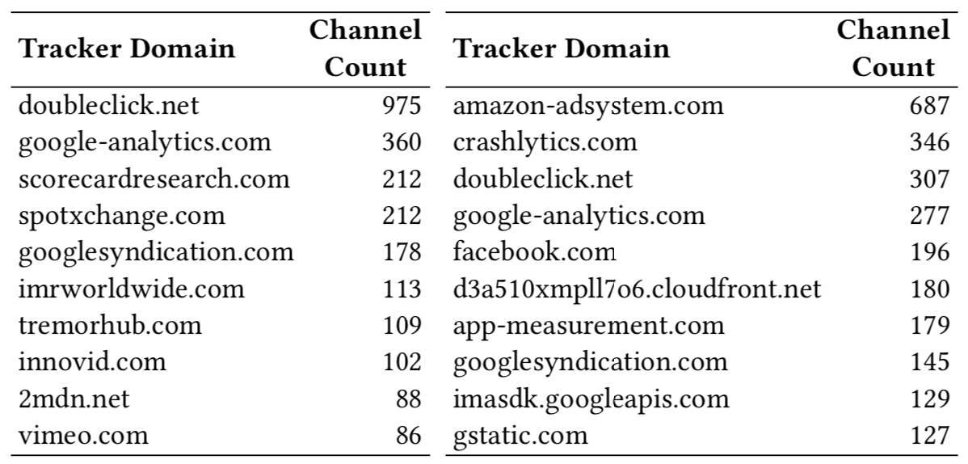
3rd-party trackers
Roku
Amazon
Notes:
Slide before this explaining what tracking domains are

Slide 80
Previously unknown trackers
Generated list of domains that
Receive AD ID or device serial number
Contacted by more then one channel
Not found in five previous lists
Manually removed false positives

Slide 81
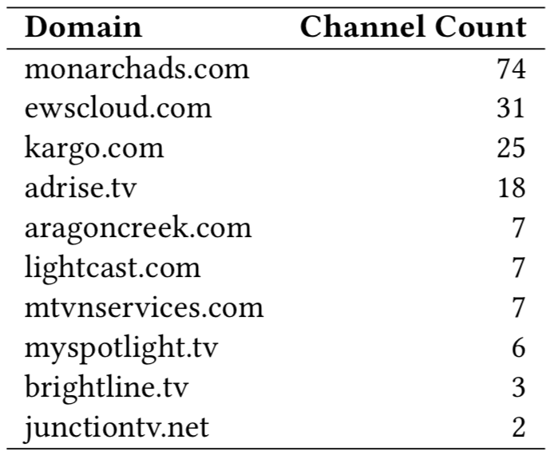
Previously unknown trackers
Roku

Slide 82
Device and location identifiers
Compiled list of possible identifiers
Account information
Manual analysis of PCAP files
Searched traffic captures for
Plain text
Encoded versions
Hashed versions
Notes:
Add example of hashing and encoding

Slide 83
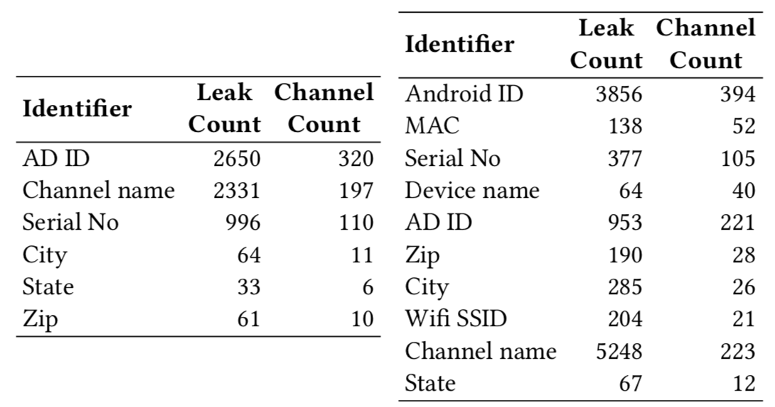
Device and location identifiers
Roku
Amazon

Slide 84
Video titles shared with 3rd-party trackers
Manually tagged 150 video titles on both platforms
Searched traffic captures for
Plain text
Encoded versions
Hashed versions

Slide 85

Video titles shared with 3rd-party trackers
Roku

Slide 86
Platform privacy options
Notes:
Limit ad tracking on Amazon, Limit on Roku this is a similar concept to Do-Not-Track.
Okay i’ve presented some pretty nasty tracking options to but it turns out that on these platforms they offer a options etc…. Etc.
Do not track is ineffective nothing users can do…. We have long term impact through regulation. There’s very limited thing pretty much users can do in the near term to protect themselves
Pihole is effective to some extent

Slide 87
Platform privacy options
Roku
Amazon
 | Track (default) | Privacy (enabled)
AD ID | 30 | 0
Serial No. | 14 | 13
 | Track (default) | Privacy (enabled)
AD ID | 35 | 16
Android ID | 69 | 65
Serial No. | 33 | 24
MAC Addr | 3 | 3
Notes:
Limit ad tracking on Amazon, Limit on Roku this is a similar concept to Do-Not-Track.
Okay i’ve presented some pretty nasty tracking options to but it turns out that on these platforms they offer a options etc…. Etc.
Do not track is ineffective nothing users can do…. We have long term impact through regulation. There’s very limited thing pretty much users can do in the near term to protect themselves
Pihole is effective to some extent

Slide 88
Implications
User’s attempts to block tracking through platform options would have minimal effect
Platform restrictions make it difficult for users to prevent tracking using conventional approaches
Previously unknown trackers would likely evade most filters
Notes:
Add slide before this discussing implications

Slide 89
Contributions
Developed an open-source automatic smart TV crawler that
Simulates a user interacting with channels
Intercepts traffic the streaming device generates
First study of thousands of channels on Roku and Amazon Fire TV
Found evidence of pervasive tracking
Numerous identifiers shared with trackers
Platform privacy options largely ineffective
Notes:
Rememer to talk about news agencies
A lot of the trackers we saw are also very pervasive in the web and mobile ecosystems

Slide 90
Future Work
Child privacy protection laws (e.g. COPPA) violations
Classifying channel traffic versus platform operating system traffic
Expand study to additional devices
Smart TVs may have additional privacy concerns
Notes:
Add slide before this discussing implications

Slide 91
Crawler and data released
Crawler code
https://tv-watches-you.princeton.edu/
Data
tvwatchesyou@princeton.edu
Notes:
Add slide before this discussing implications

Slide 92


CBS watches me watching CBS

Slide 93






Consumers face a large variety of security and privacy threats
malware attacks
privacy leaks
Who are the adversaries?
How do they cause harm?
How to protect consumers?

Slide 94


Challenges for empirically studying security & privacy threats
Challenges
I build measurement systems to study in the wild and in the lab
in the wild
discover systematic trend
measuring at scale
placing observation points
protecting privacy of subjects
discover systematic trend
in the lab
achieving realistic interactions
understanding underlying behaviors
identify initial evidence
deep-dive

Slide 95




Smart home IoT security & privacy
arXiv ‘19, CCS ‘19
in the wild
discover systematic trend
measuring at scale
placing observation points
protecting privacy of subjects
Built system that crowd-sources network traffic
in the lab
achieving realistic interactions
understanding underlying behaviors
Built system that interacts with smart TV apps
deep-dive
5k users 50k devices
tracking on smart TVs
child privacy violation
FTC investigations

Slide 96







Studying cyber-criminal ecosystem
IEEE S&P ’18, KDD ‘17, NDSS ‘14
network infrastructure
cryptocurrency payments
in the wild
discover systematic trend
measuring at scale
placing observation points
protecting privacy of subjects
Built system that interacts with criminals to study internal activities
in the lab
Built system that interacts with malware to establish ground truth
achieving realistic interactions
understanding underlying behaviors
Identify initial evidence
discovered ecosystem & weaknesses
$16 million illicit bitcoins
industry intervention
FBI investigations

Slide 97
Focus of the talk: Smart home IoT security & privacy
in the wild
discover systematic trend
Built system that crowd-sources network traffic [arXiv ‘19]
1
in the lab
Built system that interacts with smart TV apps [CCS ‘19]
2
deep-dive

Slide 98
Discovering smart home IoT security & privacy threats in the wild
1
Danny Yuxing Huang, Noah Apthorpe, Gunes Acar, Frank Li, Nick Feamster
arXiv ’19 (in submission)

Slide 99






Many smart home IoT devices, but few systematic insights
Heterogeneity in device types, design, and implementation
Diverse user behaviors in the wild

Slide 100


Challenges of identifying IoT security & privacy threats at scale
IoT security and privacy research
web & mobile
lab studies
Internet scanning
Crowdsourcing
scale
active probing
passive traffic

Slide 101
Crowdsourcing IoT network traffic at scale
Vision
Simple tool that can anyone can use to identify the otherwise hidden activities of IoT devices
Design Goals
For recruiting users
Easy to use
Generates insights
Protects privacy
For researchers
Large, labeled dataset

Slide 102


IoT Inspector: a system to crowdsource IoT traffic at scale
IoT Inspector (iot-inspector.princeton.edu)
Design Goals
For recruiting users
Easy to use
Generates insights
Protects privacy
For researchers
Large, labeled dataset

Slide 103

How to make IoT Inspector easy to use?
Design Goals
For recruiting users
Easy to use
Generates insights
Protects privacy
For researchers
Large, labeled dataset

Slide 104
IoT Inspector uses ARP spoofing to capture traffic
To router:
I’m the camera
To camera:
I’m the router

Slide 105
IoT Inspector uses ARP spoofing to capture traffic
To router:
I’m the lightbulb
To lightbulb:
I’m the router

Slide 106

IoT Inspector uses ARP spoofing to capture traffic
Challenge
Some IoT devices or routers do not accept spoofed ARP packets.

Slide 107
IoT Inspector uses TCP Ack Numbers to infer traffic rate
IoT Inspector observes outbound TCP traffic
Seq 1:100, Ack 1
Seq 100:200, Ack 1
Seq 200:300, Ack 51
Seq 300:400, Ack 72
inbound
Inbound
50 bytes
outbound
Inbound
20 bytes

Slide 108
IoT Inspector: a system to crowdsource IoT traffic at scale
IoT Inspector (iot-inspector.princeton.edu)
Usage statistics
Publicly release in May ‘19
5k+ users worldwide
50k+ devices
Passive traffic
Device labels
Examples: Smart TVs, plugs, lightbulbs, camera, Tesla

Slide 109

Design goal: to generates insights
Design Goals
For recruiting users
Easy to use
Generates insights
Protects privacy
For researchers
Large, labeled dataset

Slide 110




Screenshot of IoT Inspector from a user
Ira Flatow
Host of Science Friday
“Here is what the Princeton IoT Inspector tracked in a 20 minute time span on Ira’s Roku.”
(October 4, 2019)

Slide 111


Screenshot of IoT Inspector from a user
“Then using software from Princeton University called the IoT Inspector, I watched how each [TV] model transmitted data.”
(September 18, 2019)

Slide 112
Features of IoT Inspector
Design Goals
For recruiting users
Easy to use
Generates insights
Protects privacy
For researchers
Large, labeled dataset
Trade-off between ease of use and abuse
Detects non-IoT devices based on heuristics
User encouraged to label devices
50k devices, 20% of devices labeled

Slide 113
Findings: Ineffective encryption on IoT devices
number of devices | TLS 1.2 | TLS 1.1 | TLS 1.0 | SSL 3.0 Deprecated in 2015 | RC4 in ClientHello Attack found in 2002
669 | 645 |  | 31 |  | 9
614 | 613 | 1 | 67 | 5 | 397
148 | 129 |  | 41 |  | 80

Slide 114




Finding: Smart TVs communicate with 3rd-party ad/tracking services
blacklist
doubleclick.net
googlesyndication.com
scorecardresearch.com
fwmrm.net
69.7% of smart TVs
14.9% of smart TVs
4.3% of smart TVs
Which smart TV apps?
What sensitive data is shared?
Shared with whom?

Slide 115











Opportunities for further research
device identification
anomaly detection
3rd-party identification
healthcare

Slide 116



Summary of IoT Inspector
Built a system to gather empirical evidence of security and privacy threats from 50k+ devices and 5k users
Which smart TV apps track users?
What sensitive data is shared? With whom?
Empowers consumers with simple tool
Helps journalist raise awareness
Facilitates investigations to push for policy changes
Provides researchers with new insights

Slide 117
Summary of the talk: Smart home IoT security & privacy
in the wild
discover systematic trend
Built system that crowd-sources network traffic [arXiv ‘19]
1
in the lab
Built system that interacts with smart TV apps [CCS ‘19]
2
deep-dive

Slide 118
Analyzing tracking on smart TVs
2
Hooman Mohajeri Moghaddam, Gunes Acar, Arunesh Mathur, Ben Burgess, Danny Yuxing Huang, Prateek Mittal, Nick Feamster, Arvind Narayanan, Edward Felten
ACM Conference on Computer and Communications Security (CCS). 2019.

Slide 119
Recap: Using IoT Inspector to watch CBS
What sensitive data is shared?
From which smart TV apps?
Shared with whom?

Slide 120

Challenges of analyzing smart TV traffic in lab
tcpdump

Slide 121


Challenges of analyzing smart TV traffic in lab
tcpdump
How to analyze the traffic of channels at scale?
How to decrypt traffic?

Slide 122





Building a smart TV crawler
Design Goals
Automate TV interactions
Install and launch channels (apps)
Play videos
Detect privacy leaks
Decrypt traffic
Identify sensitive information
Challenges
web & mobile
smart TV
known tools
limited API
allows changing root cert
prohibits changing root cert

Slide 123


Our contributions
Design Goals
Automate TV interactions
Install and launch channels (apps)
Play videos
Detect privacy leaks
Decrypt traffic
Identify sensitive information
Contributions
Built general-purpose smart TV crawler
First large-scale analysis of channels
Sensitive info shared with 3rd party ad/tracking services
Tracking on children without consent

Slide 124


Automating interactions with smart TVs
Design Goals
Automate TV interactions
Install and launch channels (apps)
Play videos
remote control commands
video & audio via USB
network
traffic
HDMI output
HDMI capture card

Slide 125

TV crawler interacting with a single channel

Slide 126

TV crawler interacting with channels

Slide 127

Challenges of automatic interactions with channels
navigating to video
detecting video playback

Slide 128
Challenges of automatic interactions with channels
navigating to video
detecting video playback
Sample 100 channels and find popular key sequences:
[OK, OK, OK]
[Down, OK, OK]
[OK, OK, Down, OK, Down, OK]
Crawler brute-forces key sequences
Detect at least 5 seconds of audio playback

Slide 129
Detecting video playback
audio detected (62%)
No audio detected (38%)
manual sample
manual sample
correct (96%)
FP
stuck (75%)
no video

Slide 130
Design goals
Design Goals
Automate TV interactions
Install and launch channels (apps)
Play videos
Detect privacy leaks
Decrypt traffic
Identify sensitive information

Slide 131
Detecting privacy leaks
Design Goals
Automate TV interactions
Install and launch channels (apps)
Play videos
Detect privacy leaks
Decrypt traffic
Identify sensitive information
network
traffic
man-in-the-middle the connection
set up a fake account

Slide 132
Man-in-the-middling traffic
Rooted device
Changed to our certificate
Used Frida to bypass channel-level certificate pinning
Decrypted almost all connections
Unable to root device
Opportunistic man-in-the-middling
validates cert
Server 1
Server 2
Server 3
does not validate cert
Decrypted at least one connection from 5% of the channels

Slide 133
Findings: Ad/tracking companies
 | % channels |  | % channels
Google (Double Click) | 98%
Google Analytics | 36%
Score Card Research | 21%
SpotXchange | 21%
Innovid | 10%

Slide 134
Findings: Ad/tracking companies
 | % channels |  | % channels
Google (Double Click) | 98% | Crashalytics | 35%
Google Analytics | 36% | Google (Double Click) | 31%
Score Card Research | 21% | Google Analytics | 28%
SpotXchange | 21% | Facebook | 20%
Innovid | 10% | App-Measurement.com | 18%

Slide 135
Findings: Sensitive data shared with ad/tracking services
 | % channels |  | % channels
Ad ID | 32%
Channel name | 20%
Serial number | 11%
Zip code | 1%
City or state | 1%

Slide 136
Findings: Sensitive data shared with ad/tracking services
 | % channels |  | % channels
Ad ID | 32% | Android ID | 39%
Channel name | 20% | Ad ID | 22%
Serial number | 11% | Serial number | 10%
Zip code | 1% | MAC address | 5%
City or state | 1% | WiFi SSID | 2%

Slide 137

Privacy for children?
September 4, 2019
The “FTC and New York Attorney General allege that YouTube violated the COPPA Rule by collecting personal information—in the form of persistent identifiers that are used to track users across the Internet—from viewers of child-directed channels, without first notifying parents and getting their consent.”

Slide 138
Findings: Privacy leaks in child-directed channels
Number of channels | 1,882 | 1,183
Number of child-directed channels | 470 | 220
Number of child-directed channels that leaked persistent IDs | 34 | 23

Slide 139


Examples of persistent IDs in child-directed channels
Leaked
Android ID
Leaked
Android ID
Serial Number

Slide 140


Examples of persistent IDs in child-directed channels
Leaked
Ad ID
Serial Number
Leaked
Ad ID
Serial Number
We are currently working with the FTC for further investigations.

Slide 141


DNS-based block lists may cause some channels to crash
network
traffic

Slide 142
Limited ad tracking (Roku) / No interest-based ads (Amazon)

Slide 143
Finding: Channels still shared persistent IDs under “limited ads”
 | Default % channels | “Limited Ads” % channels |  | Default % channels | No “Interest-based Ads” % channels
Ad ID |  |  | Ad ID
Serial number |  |  | Android ID
 |  |  | Serial number
 |  |  | MAC address

Slide 144
Finding: Channels still shared persistent IDs under “limited ads”
 | Default % channels | “Limited Ads” % channels |  | Default % channels | No “Interest-based Ads” % channels
Ad ID | 30% |  | Ad ID | 35%
Serial number | 14% |  | Android ID | 69%
 |  |  | Serial number | 33%
 |  |  | MAC address | 3%

Slide 145
Finding: Channels still shared persistent IDs under “limited ads”
 | Default % channels | “Limited Ads” % channels |  | Default % channels | No “Interest-based Ads” % channels
Ad ID | 30% | 0% | Ad ID | 35% | 16%
Serial number | 14% | 13% | Android ID | 69% | 65%
 |  |  | Serial number | 33% | 24%
 |  |  | MAC address | 3% | 3%

Slide 146

Summary of tracking on smart TVs
Built Smart TV Crawler, a system to gather empirical evidence of privacy threats from smart TVs
Automatic interactions with channels at scale
Man-in-the-middling (decrypting) channel traffic
First large-scale analysis of smart TV channels
Channels shared sensitive info with 3rd party ad/tracking services
Potential violations of online privacy laws for children
Working with FTC for further investigation

